Slide 1
Multiple logistic regression and interpretations

Slide 2
Class 8 Learning Objectives
From last class: Interpret coefficient estimates for continuous variables in simple logistic regression
Construct and fit a multiple logistic regression model
Test for significance of individual coefficients or sets of coefficients
Estimate the predicted probability of our outcome
Interpret odds ratios for coefficients while adjusting for other variables

Slide 3
Class 8 Learning Objectives
From last class: Interpret coefficient estimates for continuous variables in simple logistic regression
Construct and fit a multiple logistic regression model
Test for significance of individual coefficients or sets of coefficients
Estimate the predicted probability of our outcome
Interpret odds ratios for coefficients while adjusting for other variables

Slide 4
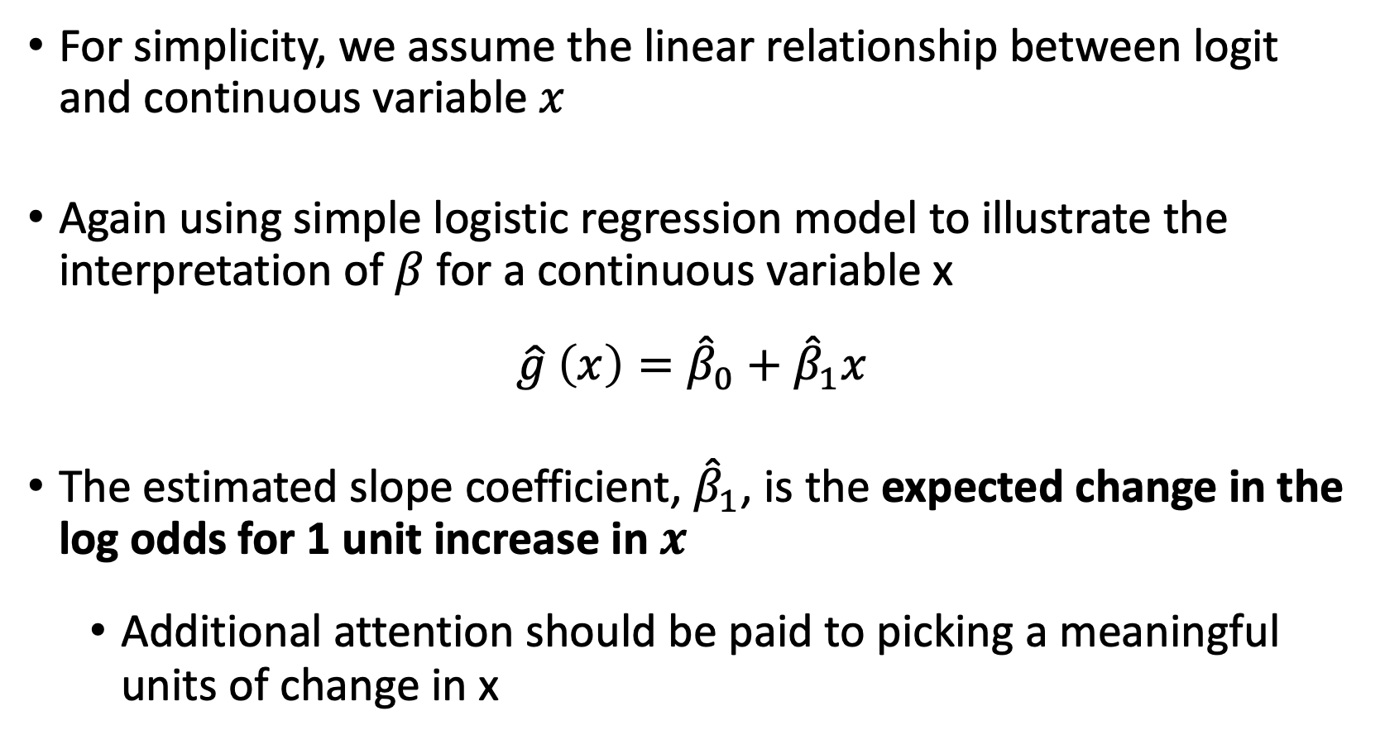
Coefficient Interpretation: Continuous Independent Variable (I)
For simplicity, we assume the linear relationship between logit and continuous variable $x$
Again using simple logistic regression model to illustrate the interpretation of $β$ for a continuous variable x
$$\hat{g} \left(x\right)={\hat{β}}_{0}+{\hat{β}}_{1}x$$
The estimated slope coefficient, ${\hat{β}}_{1}$, is the expected change in the log odds for 1 unit increase in $x$
Additional attention should be paid to picking a meaningful units of change in x

Slide 5
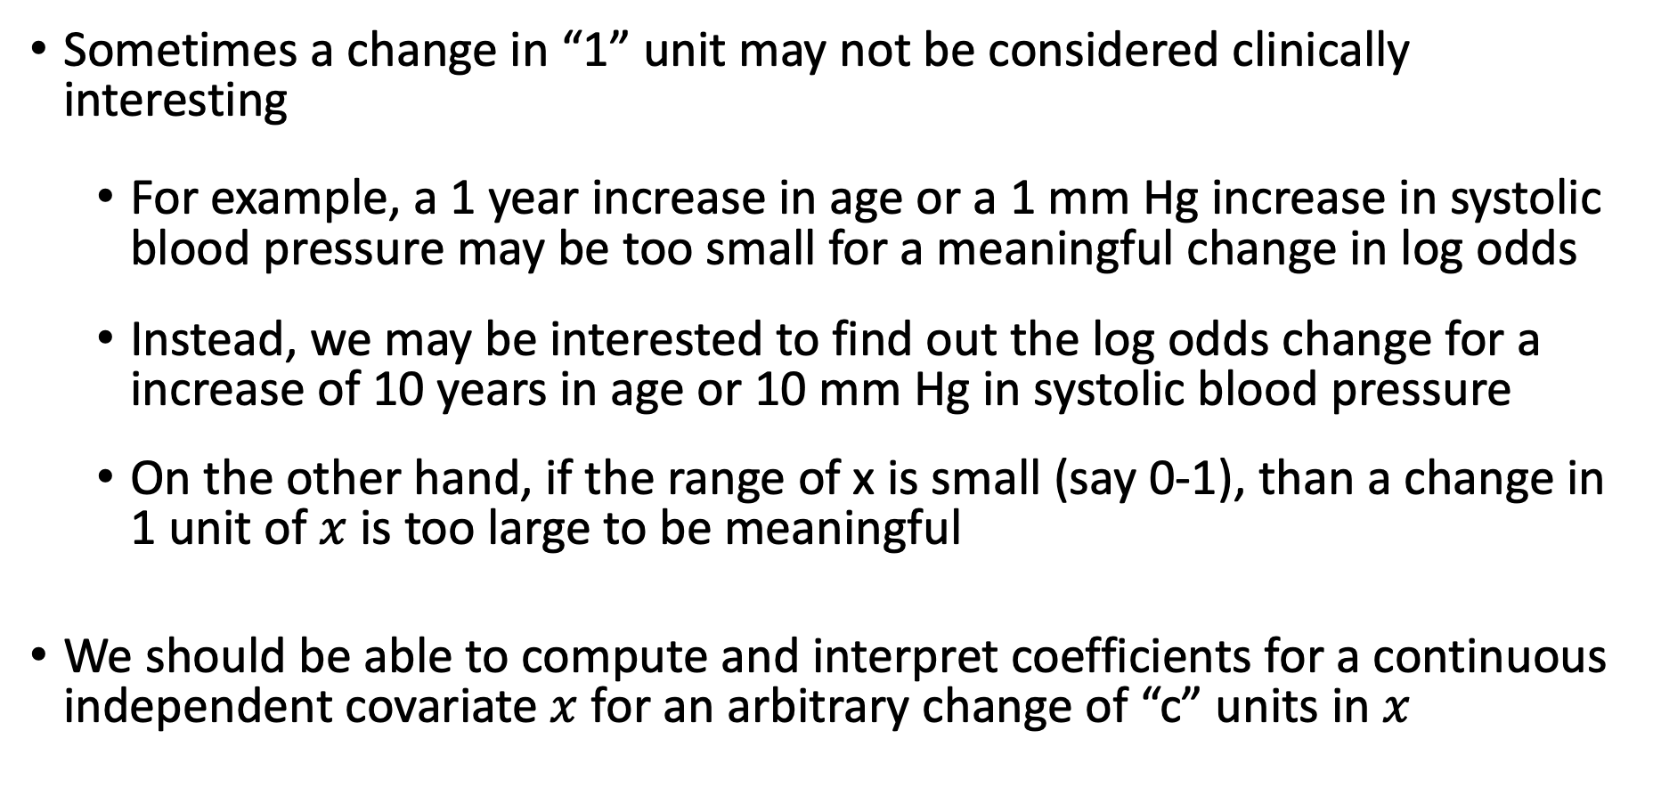
Coefficient Interpretation: Continuous Independent Variable (II)
Sometimes a change in “1” unit may not be considered clinically interesting
For example, a 1 year increase in age or a 1 mm Hg increase in systolic blood pressure may be too small for a meaningful change in log odds
Instead, we may be interested to find out the log odds change for a increase of 10 years in age or 10 mm Hg in systolic blood pressure
On the other hand, if the range of x is small (say 0-1), than a change in 1 unit of $x$ is too large to be meaningful
We should be able to compute and interpret coefficients for a continuous independent covariate $x$ for an arbitrary change of “c” units in $x$
Notes:
mm Hg reads millimeter of mercury

Slide 6
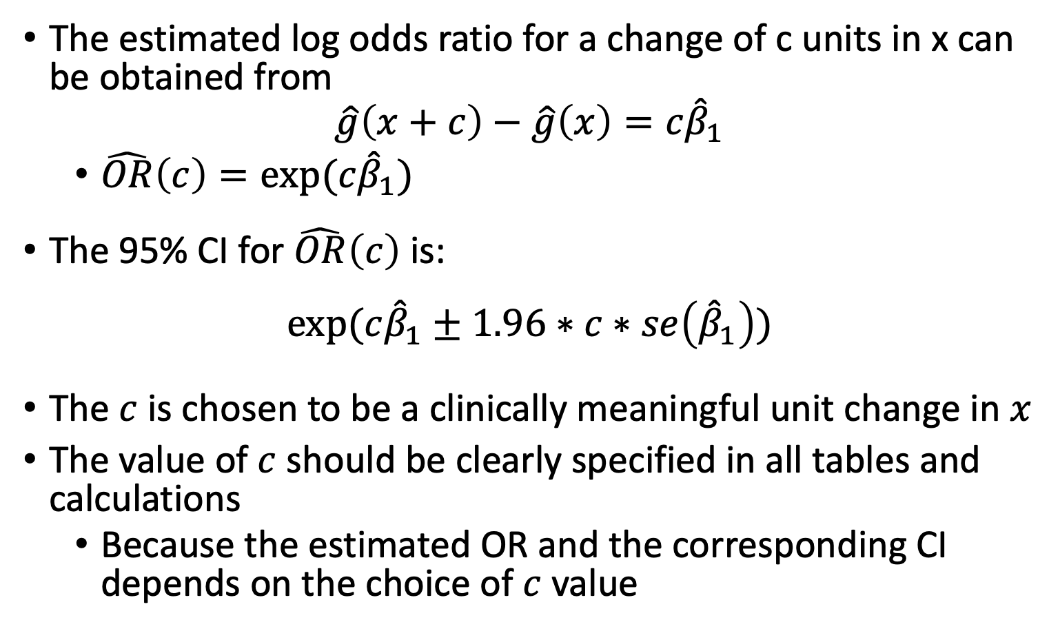
Coefficient Interpretation: Continuous Independent Variable (III)
The estimated log odds ratio for a change of c units in x can be obtained from
$$\hat{g}\left(x+c\right)−\hat{g}\left(x\right)=c{\hat{β}}_{1}$$
$\hat{OR}\left(c\right)=exp⁡(c{\hat{β}}_{1})$
The 95% CI for $\hat{OR}\left(c\right)$ is:
$$exp⁡(c{\hat{β}}_{1}±1.96∗c∗se\left({\hat{β}}_{1}\right))$$
The $c$ is chosen to be a clinically meaningful unit change in $x$
The value of $c$ should be clearly specified in all tables and calculations
Because the estimated OR and the corresponding CI depends on the choice of $c$ value

Slide 7
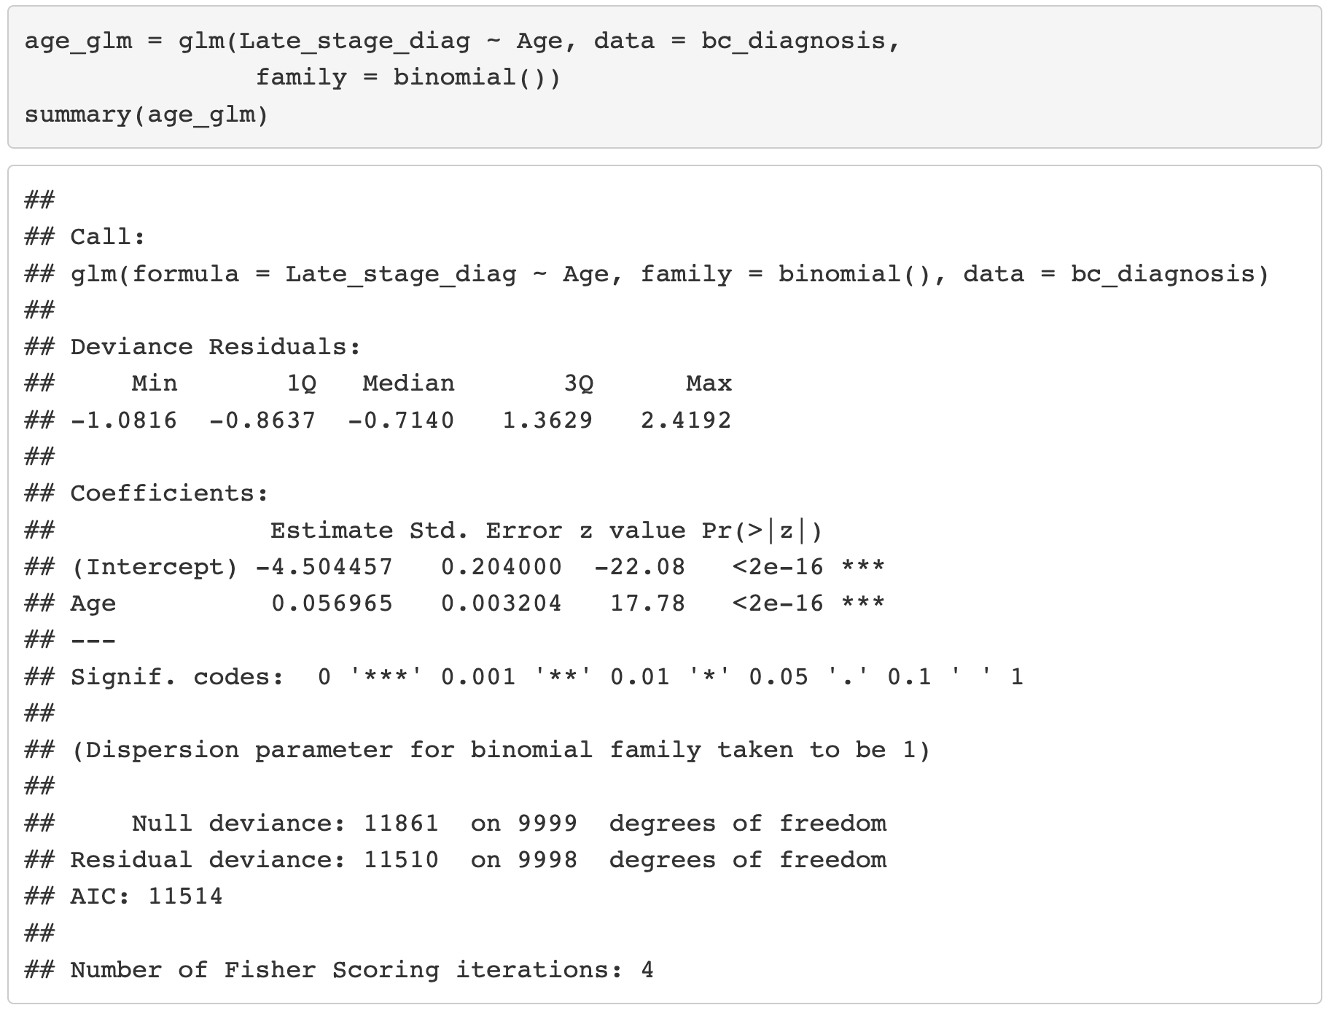
Example: Age and Late Stage Diagnosis (I)

Slide 8
Example: Age and Late Stage Diagnosis (I)

Slide 9
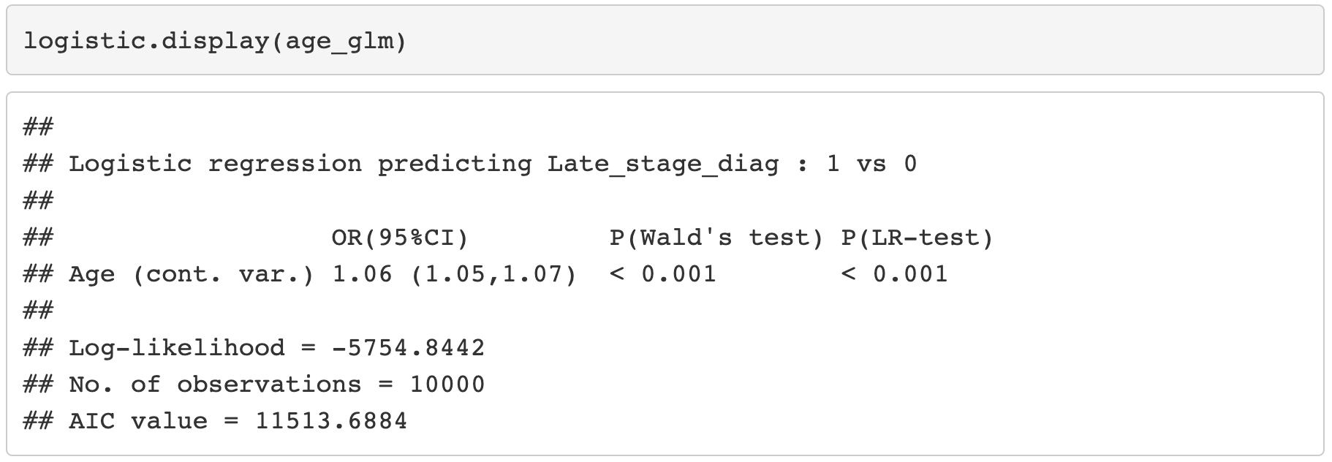
Example: Age and Late Stage Diagnosis (II)

Slide 10
Example: Age and Late Stage Diagnosis (II)

Slide 11
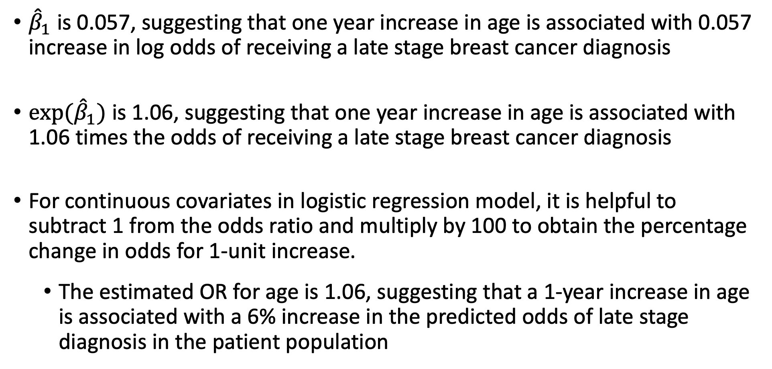
Example: Interpretation of Age Coefficient/OR (I)
${\hat{β}}_{1}$ is 0.057, suggesting that one year increase in age is associated with 0.057 increase in log odds of receiving a late stage breast cancer diagnosis
${exp⁡(\hat{β}}_{1})$ is 1.06, suggesting that one year increase in age is associated with 1.06 times the odds of receiving a late stage breast cancer diagnosis
For continuous covariates in logistic regression model, it is helpful to subtract 1 from the odds ratio and multiply by 100 to obtain the percentage change in odds for 1-unit increase.
The estimated OR for age is 1.06, suggesting that a 1-year increase in age is associated with a 6% increase in the predicted odds of late stage diagnosis in the patient population

Slide 12
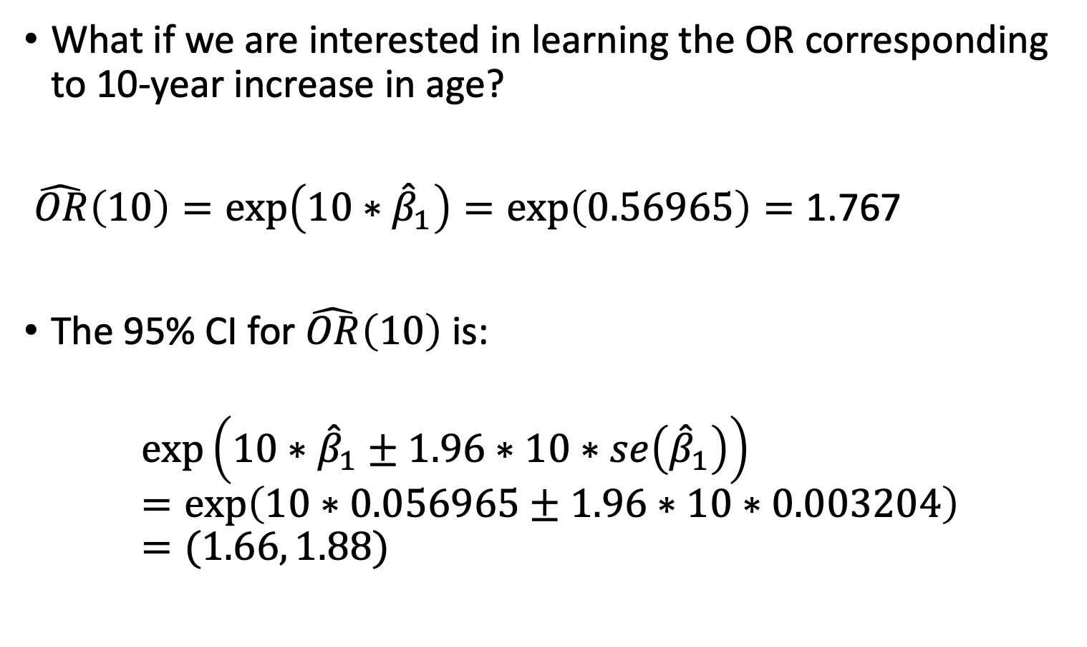
Example: Interpretation of Age Coefficient/OR (II)
What if we are interested in learning the OR corresponding to 10-year increase in age?
$\hat{OR}\left(10\right)=\exp\left(10∗{\hat{β}}_{1}\right)=\exp\left(0.56965\right)=\text{1.767}$
The 95% CI for $\hat{OR}\left(10\right)$ is:
$$\exp\left(10∗{\hat{β}}_{1}±1.96∗10∗se\left({\hat{β}}_{1}\right)\right)=\exp\left(10∗0.056965±1.96∗10∗0.003204\right)=(1.66, 1.88)$$

Slide 13
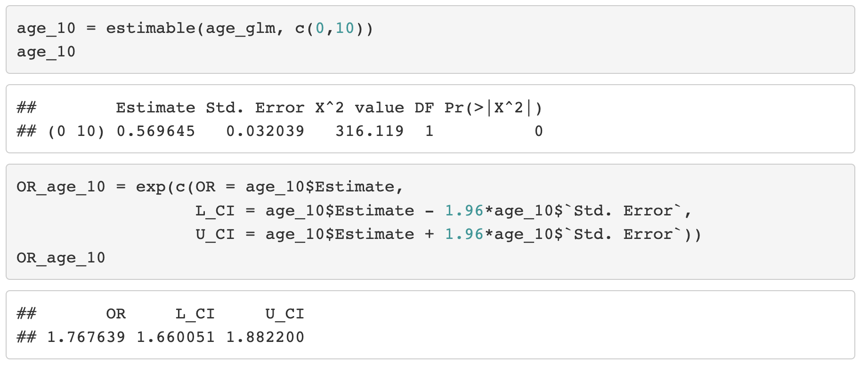
Example: Interpretation of Age Coefficient/OR (III)

Slide 14
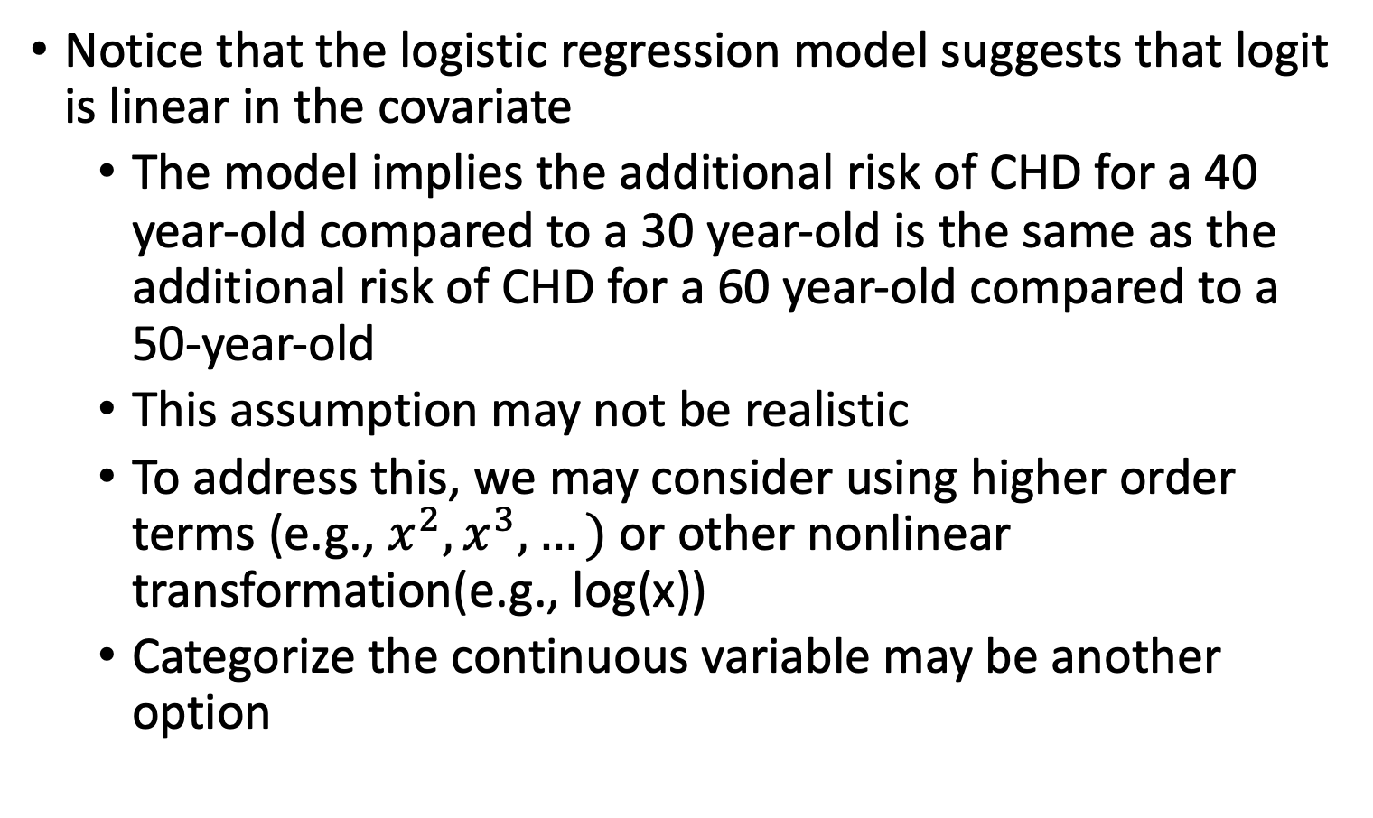
Last Note About Continuous Independent Variable
Notice that the logistic regression model suggests that logit is linear in the covariate
The model implies the additional risk of CHD for a 40 year-old compared to a 30 year-old is the same as the additional risk of CHD for a 60 year-old compared to a 50-year-old
This assumption may not be realistic
To address this, we may consider using higher order terms (e.g., $x^{2}, x^{3},…)$or other nonlinear transformation(e.g., log(x))
Categorize the continuous variable may be another option

Slide 15
Class 8 Learning Objectives
From last class: Interpret coefficient estimates for continuous variables in simple logistic regression
Construct and fit a multiple logistic regression model
Test for significance of individual coefficients or sets of coefficients
Estimate the predicted probability of our outcome
Interpret odds ratios for coefficients while adjusting for other variables

Slide 16
Introduction to Multiple Logistic Regression
In multiple logistic regression model, we have > 1 independent variable
Sometimes referred to as the “multivariable regression”.
The independent variable can be any type:
Continuous
Categorical (ordinal or nominal)
We will follow similar procedures as we did for simple logistic regression
But we need to change our interpretation of estimates

Slide 17
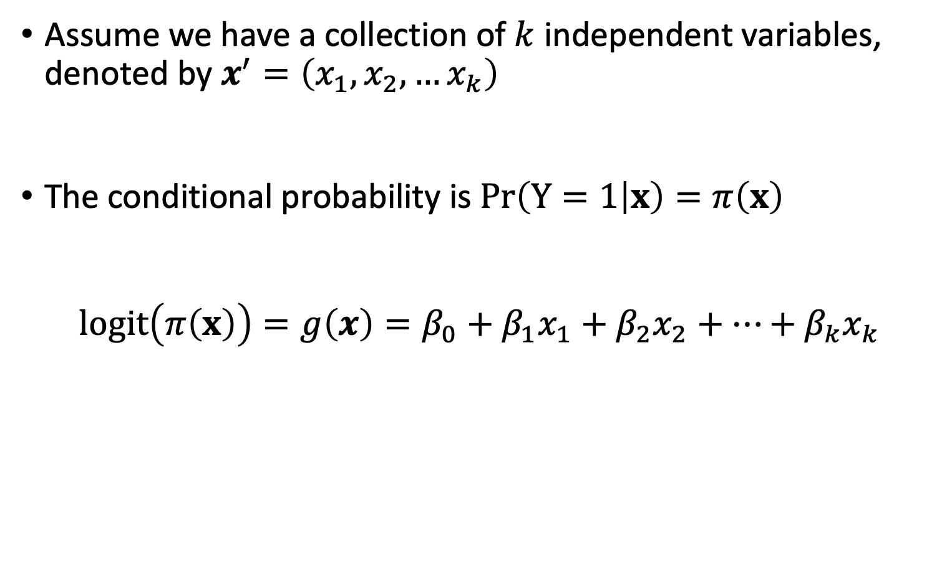
Multiple Logistic Regression Model (I)
Assume we have a collection of $k$ independent variables, denoted by $x^{′}=\left(x_{1},x_{2},…x_{k}\right)$
The conditional probability is $Pr\left(Y=1 | x\right)=π\left(x\right)$
$$logit\left(π\left(x\right)\right)=g\left(x\right)=β_{0}+β_{1}x_{1}+β_{2}x_{2}+…+β_{k}x_{k}$$

Slide 18
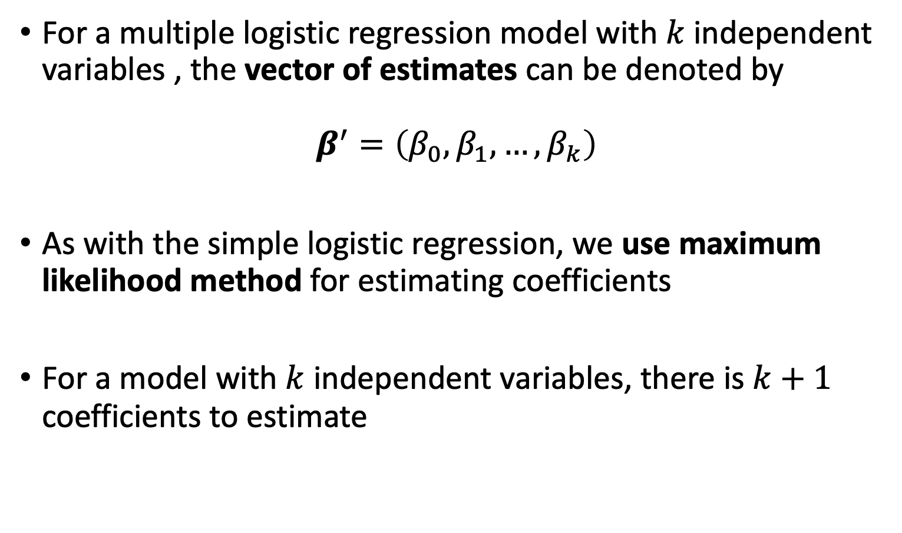
Fitting the Multiple Logistic Regression Model (I)
For a multiple logistic regression model with $k$ independent variables , the vector of estimates can be denoted by
$β^{′}=\left(β_{0},β_{1},…, β_{k}\right)$
As with the simple logistic regression, we use maximum likelihood method for estimating coefficients
For a model with $k$ independent variables, there is $k+1$ coefficients to estimate

Slide 19
Breast Cancer Example
For breast cancer diagnosis example, recall:
Outcome: early or late stage breast cancer diagnosis
Primary Covariate: Race/ethnicity
While non-Hispanic white individuals are more likely to be diagnosed with breast cancer, non-Hispanic black individuals have the highest death rate
Racism affecting health care quality
Additional covariate: Age
Also a risk factor for cancer diagnosis
We want to fit a multiple logistic regression model with both risk factors included as dependent variables
https://www.ncbi.nlm.nih.gov/pmc/articles/PMC6941147/
https://www.nature.com/articles/s41572-021-00258-1

Slide 20
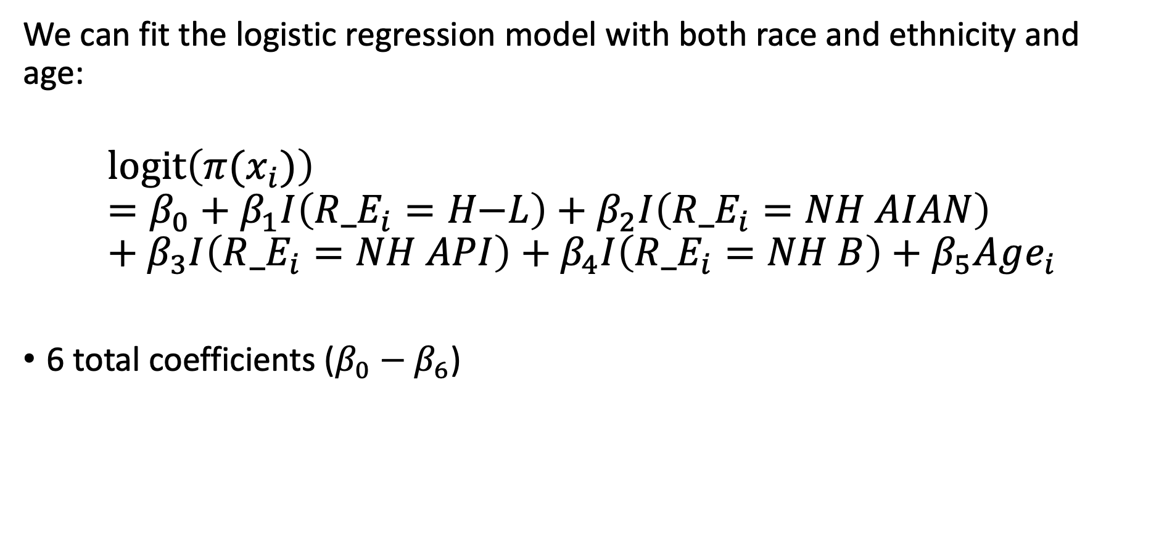
Breast Cancer Example: Model
We can fit the logistic regression model with both race and ethnicity and age:
$$l\text{ogit}\left(π(x_{i})\right)=β_{0}+β_{1}I\left({R_E}_{i}=H\text{−}L\right)+β_{2}I\left({R_E}_{i}=NH AIAN\right)+β_{3}I\left({R_E}_{i}=NH API\right)+β_{4}I\left({R_E}_{i}=NH B\right)+β_{5}Age_{i}$$
6 total coefficients ($β_{0}−β_{6}$)

Slide 21
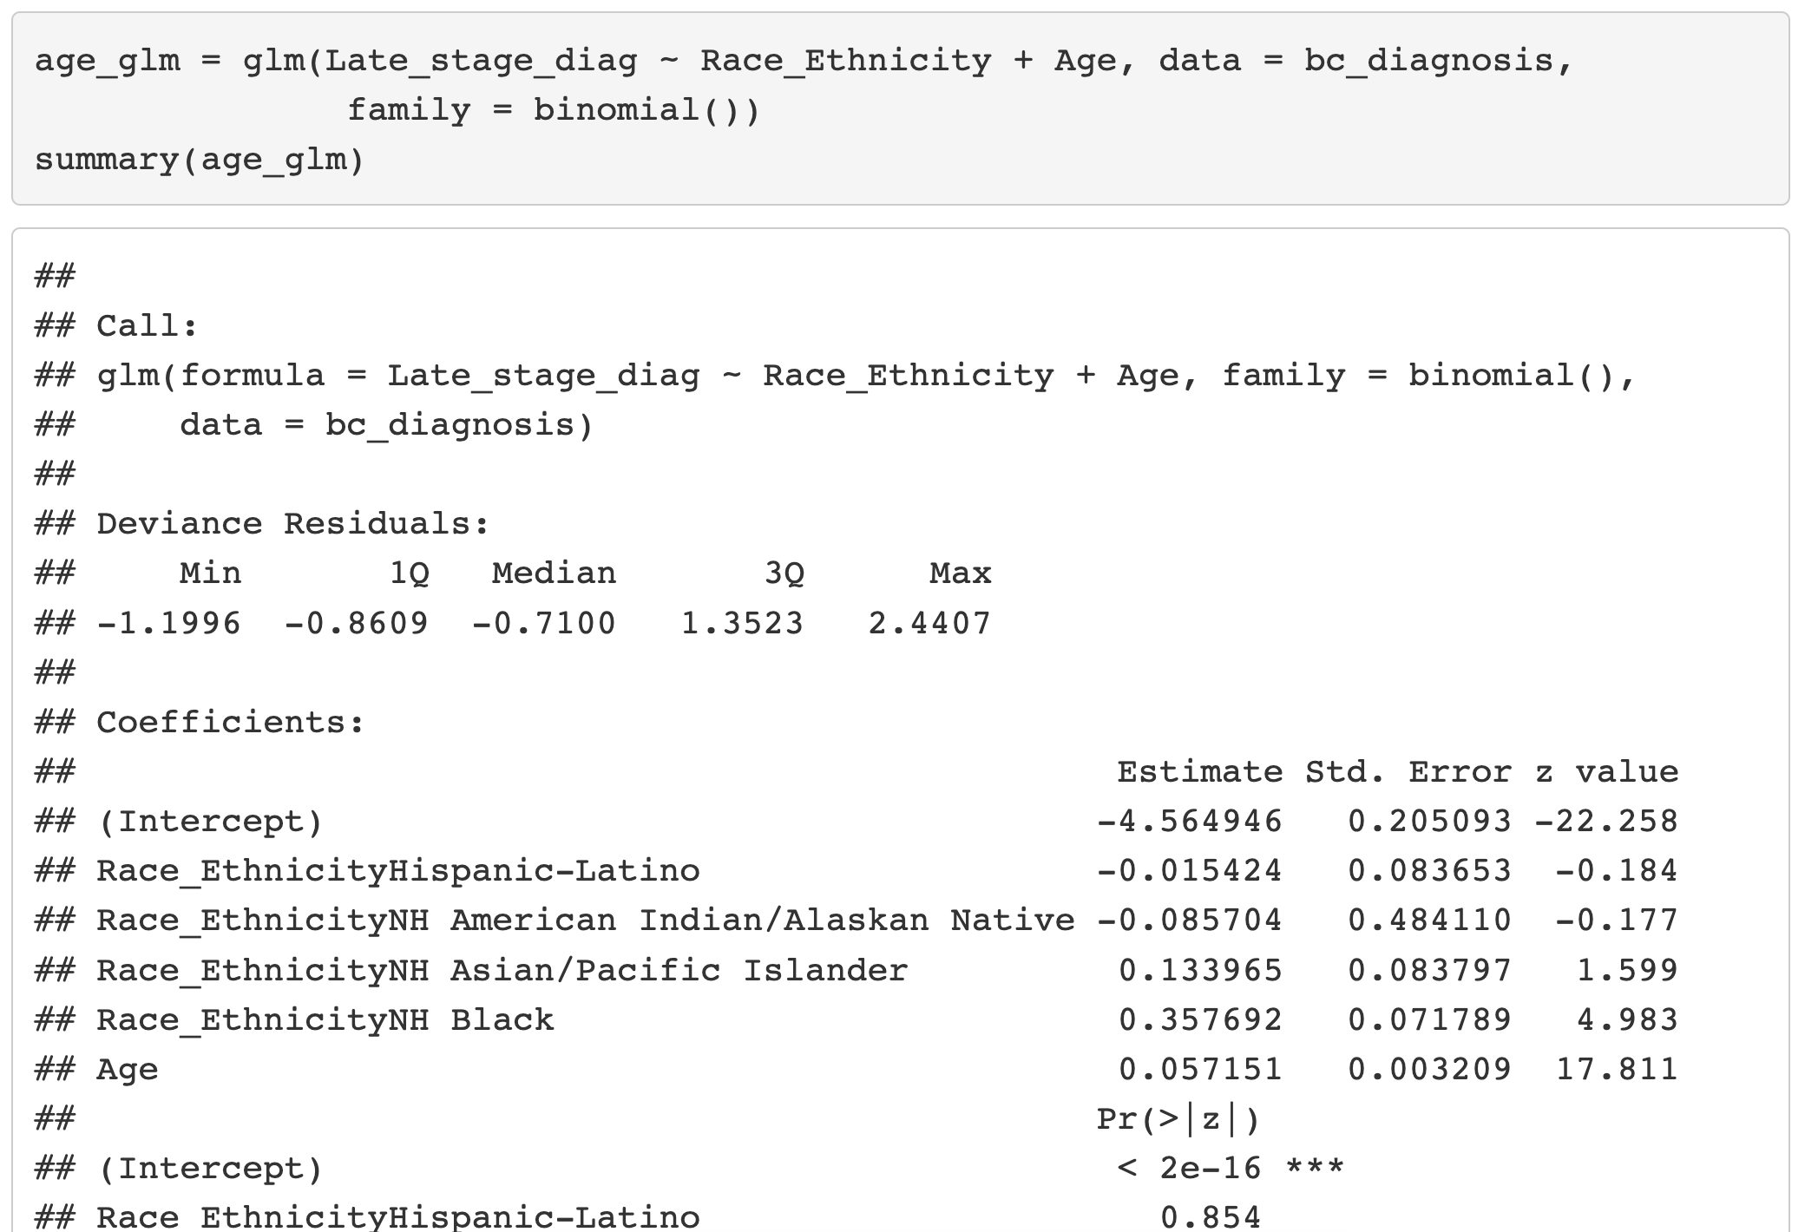

Fitting Multiple Logistic Regression Model

Slide 22
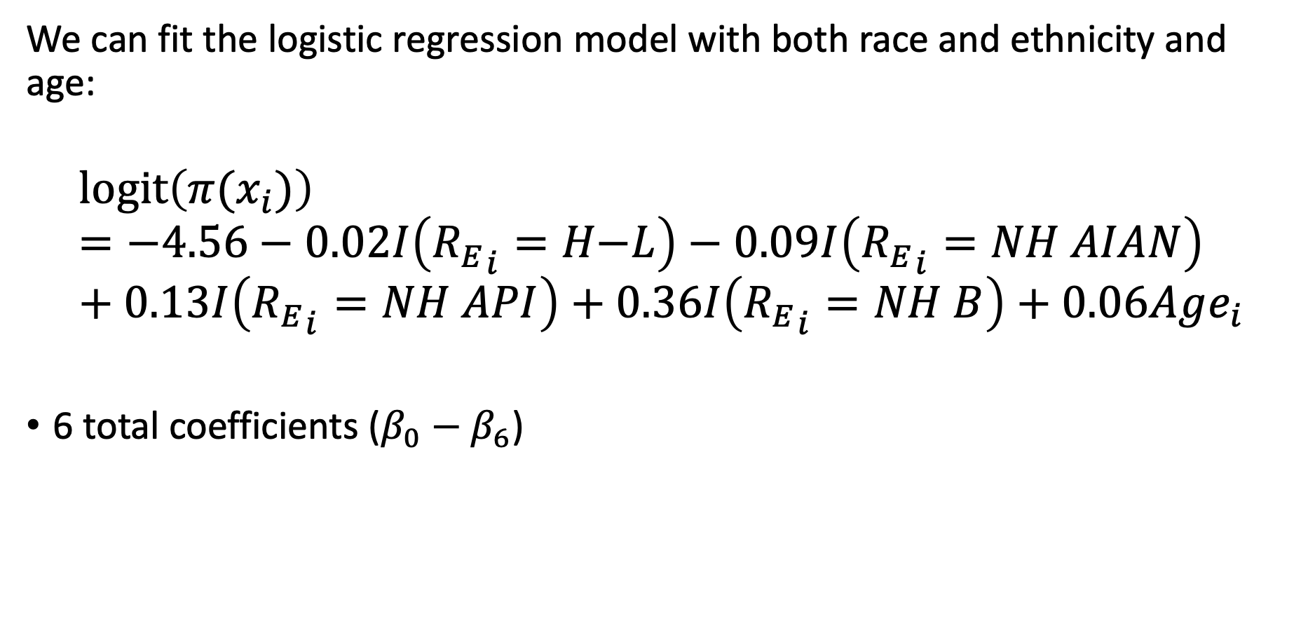
Breast Cancer Example: Fitted Model
We can fit the logistic regression model with both race and ethnicity and age:
$$l\text{ogit}\left(π(x_{i})\right)=−4.56−0.02I\left({R_{E}}_{i}=H\text{−}L\right)−0.09I\left({R_{E}}_{i}=NH AIAN\right)+0.13I\left({R_{E}}_{i}=NH API\right)+0.36I\left({R_{E}}_{i}=NH B\right)+0.06Age_{i}$$
6 total coefficients ($β_{0}−β_{6}$)

Slide 23
Class 8 Learning Objectives
From last class: Interpret coefficient estimates for continuous variables in simple logistic regression
Construct and fit a multiple logistic regression model
Test for significance of individual coefficients or sets of coefficients
Estimate the predicted probability of our outcome
Interpret odds ratios for coefficients while adjusting for other variables

Slide 24
Testing Significance of the Coefficients
Refer to Class 6 slides 16-38 and Class 7 slides 6-10
We use the same three tests that we discussed in Simple Logistic Regression to test individual coefficients
Wald test
Score test
Likelihood ratio test
Textbook and our class focuses on Wald and LRT only

Slide 25
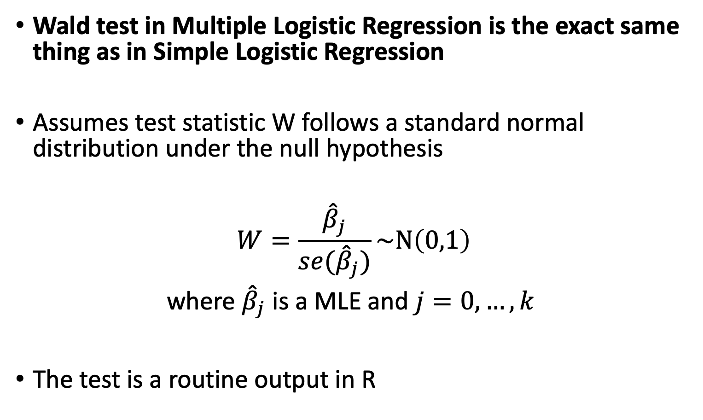
Wald Test
Wald test in Multiple Logistic Regression is the exact same thing as in Simple Logistic Regression
Assumes test statistic W follows a standard normal distribution under the null hypothesis
$$W=\frac{{\hat{β}}_{j}}{se({\hat{β}}_{j})}\sim N\left(0,1\right)$$
where ${\hat{β}}_{j}$ is a MLE and $j=0, …,k$
The test is a routine output in R

Slide 26
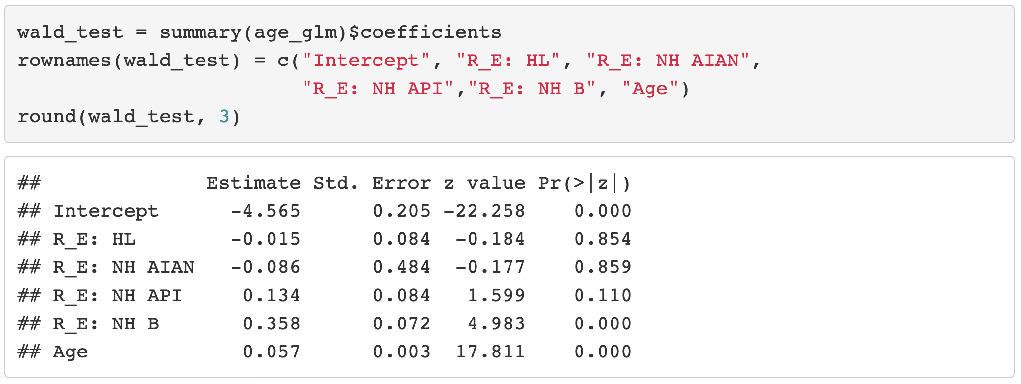
Wald Test in R

Slide 27
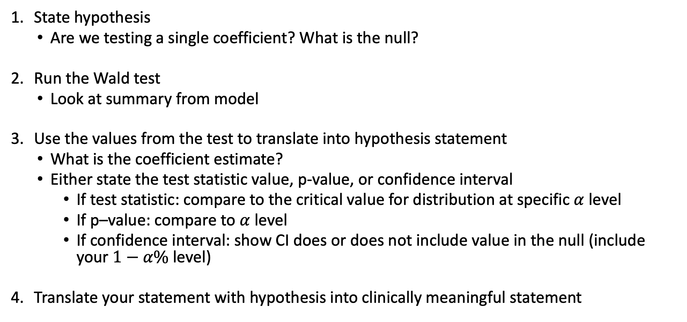
Wald Test Process
State hypothesis
Are we testing a single coefficient? What is the null?
Run the Wald test
Look at summary from model
Use the values from the test to translate into hypothesis statement
What is the coefficient estimate?
Either state the test statistic value, p-value, or confidence interval
If test statistic: compare to the critical value for distribution at specific $α$ level
If p–value: compare to $α$ level
If confidence interval: show CI does or does not include value in the null (include your $1−α\%$ level)
Translate your statement with hypothesis into clinically meaningful statement

Slide 28
Likelihood Ratio Test (I)
Likelihood ratio test answers the question:
For a specific covariate, which model tell us more about the outcome variable: the model including the covariate or the model omitting the covariate?
For a set of covariates, which model tell us more about the outcome variable: the model including the set of covariates or the model omitting the set of covariates?

Slide 29
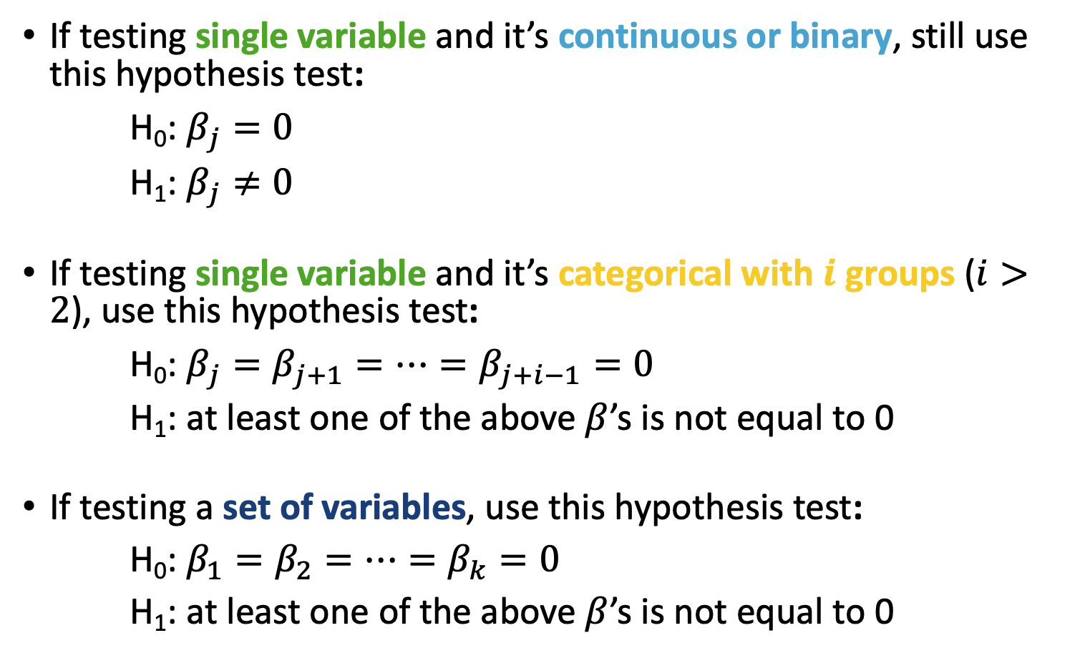
Likelihood Ratio Test (II)
If testing single variable and it’s continuous or binary, still use this hypothesis test:
H₀: $β_{j}=0$
H₁: $β_{j}≠0$
If testing single variable and it’s categorical with $i$ groups ($i>2$), use this hypothesis test:
H₀: $β_{j}=β_{j+1}=…=β_{j+i−1}=0$
H₁: at least one of the above $β$’s is not equal to 0
If testing a set of variables, use this hypothesis test:
H₀:$β_{1}=β_{2}=…=β_{k}=0$
H₁: at least one of the above $β$’s is not equal to 0

Slide 30
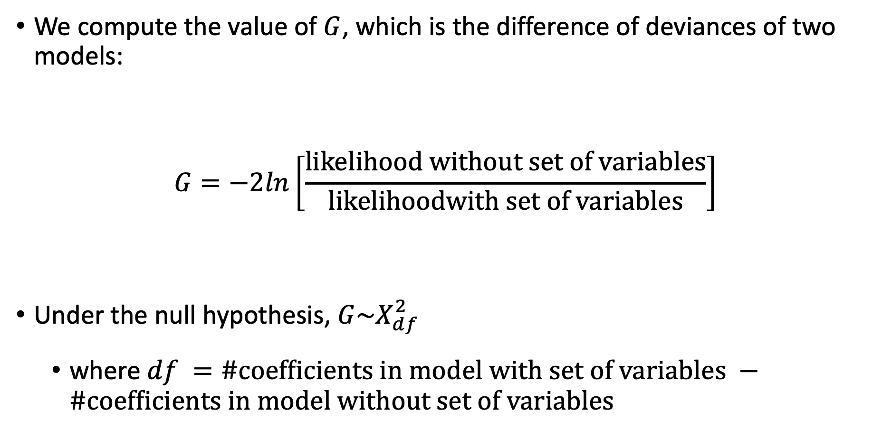
Likelihood Ratio Test (III)
We compute the value of $G$, which is the difference of deviances of two models:
$$G=−2ln\left[\frac{likelihood without set of variables}{likelihoodwith set of variables}\right]$$
Under the null hypothesis, $G\sim X_{df}^{2}$
where $df =\#coefficients in model with set of variables −\#coefficients in model without set of variables$

Slide 31
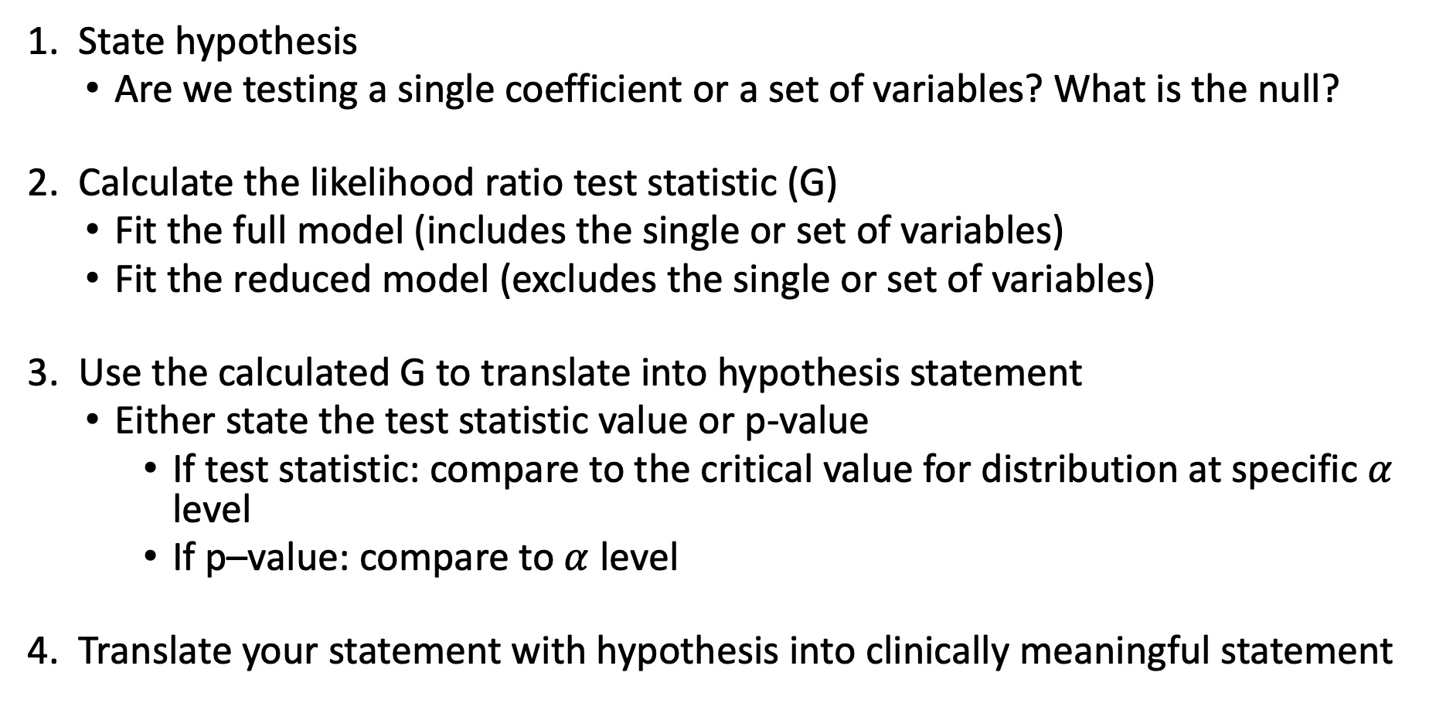
Likelihood Ratio Test Process
State hypothesis
Are we testing a single coefficient or a set of variables? What is the null?
Calculate the likelihood ratio test statistic (G)
Fit the full model (includes the single or set of variables)
Fit the reduced model (excludes the single or set of variables)
Use the calculated G to translate into hypothesis statement
Either state the test statistic value or p-value
If test statistic: compare to the critical value for distribution at specific $α$ level
If p–value: compare to $α$ level
Translate your statement with hypothesis into clinically meaningful statement

Slide 32
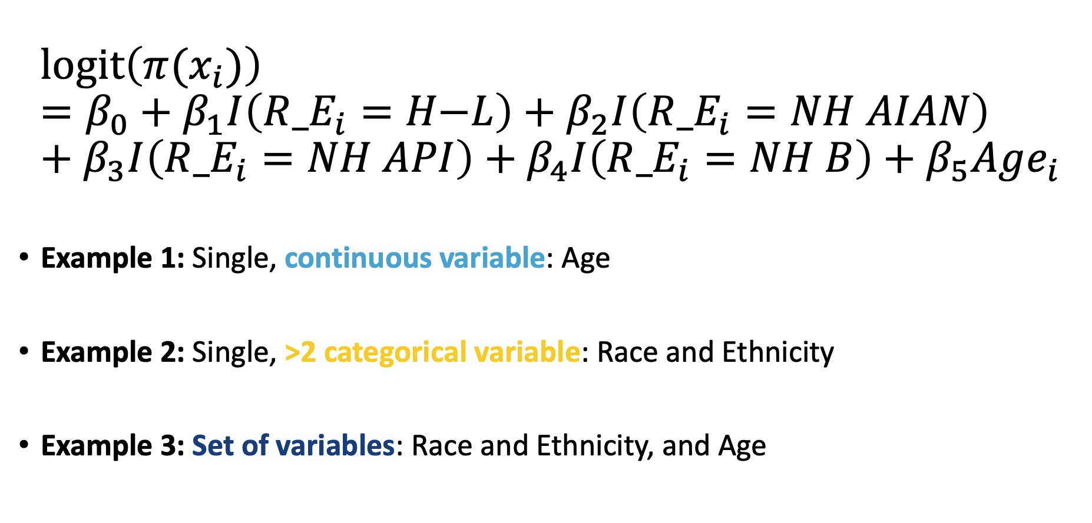
LRT Examples: Breast Cancer Diagnosis
$$l\text{ogit}\left(π(x_{i})\right)=β_{0}+β_{1}I\left({R_E}_{i}=H\text{−}L\right)+β_{2}I\left({R_E}_{i}=NH AIAN\right)+β_{3}I\left({R_E}_{i}=NH API\right)+β_{4}I\left({R_E}_{i}=NH B\right)+β_{5}Age_{i}$$
Example 1: Single, continuous variable: Age
Example 2: Single, >2 categorical variable: Race and Ethnicity
Example 3: Set of variables: Race and Ethnicity, and Age

Slide 33
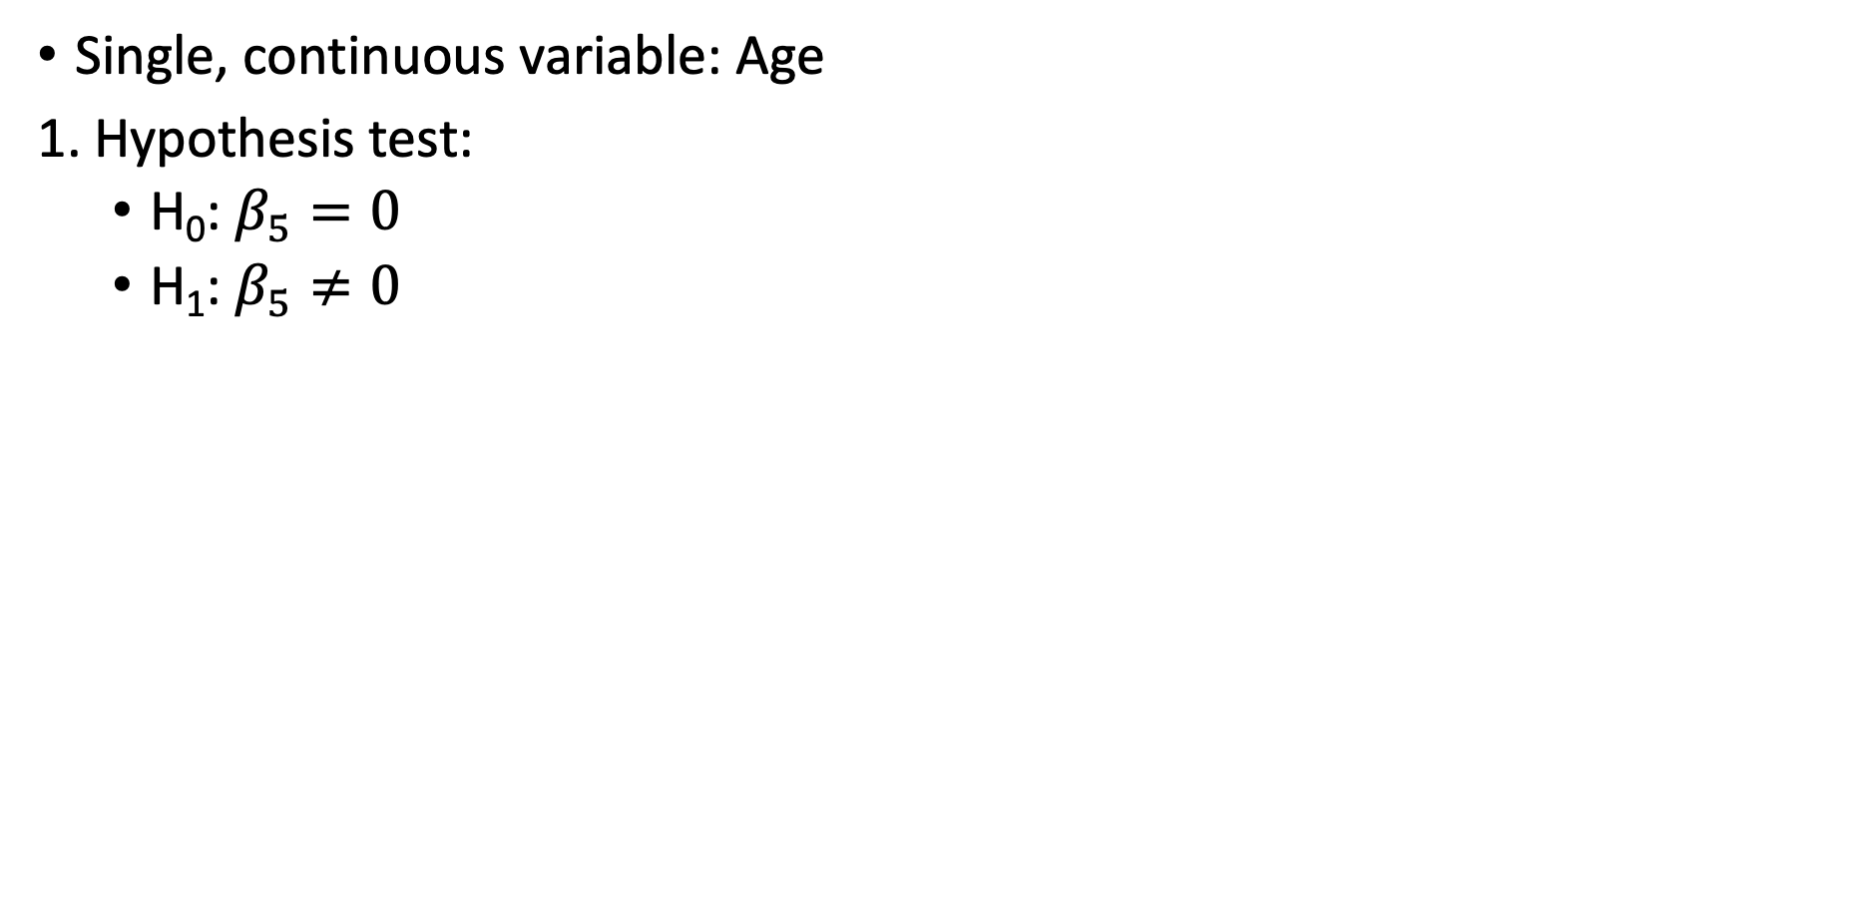
LRT Example 1: Breast Cancer Diagnosis (I)
Single, continuous variable: Age
Hypothesis test:
H₀: $β_{5}=0$
H₁: $β_{5}≠0$

Slide 34
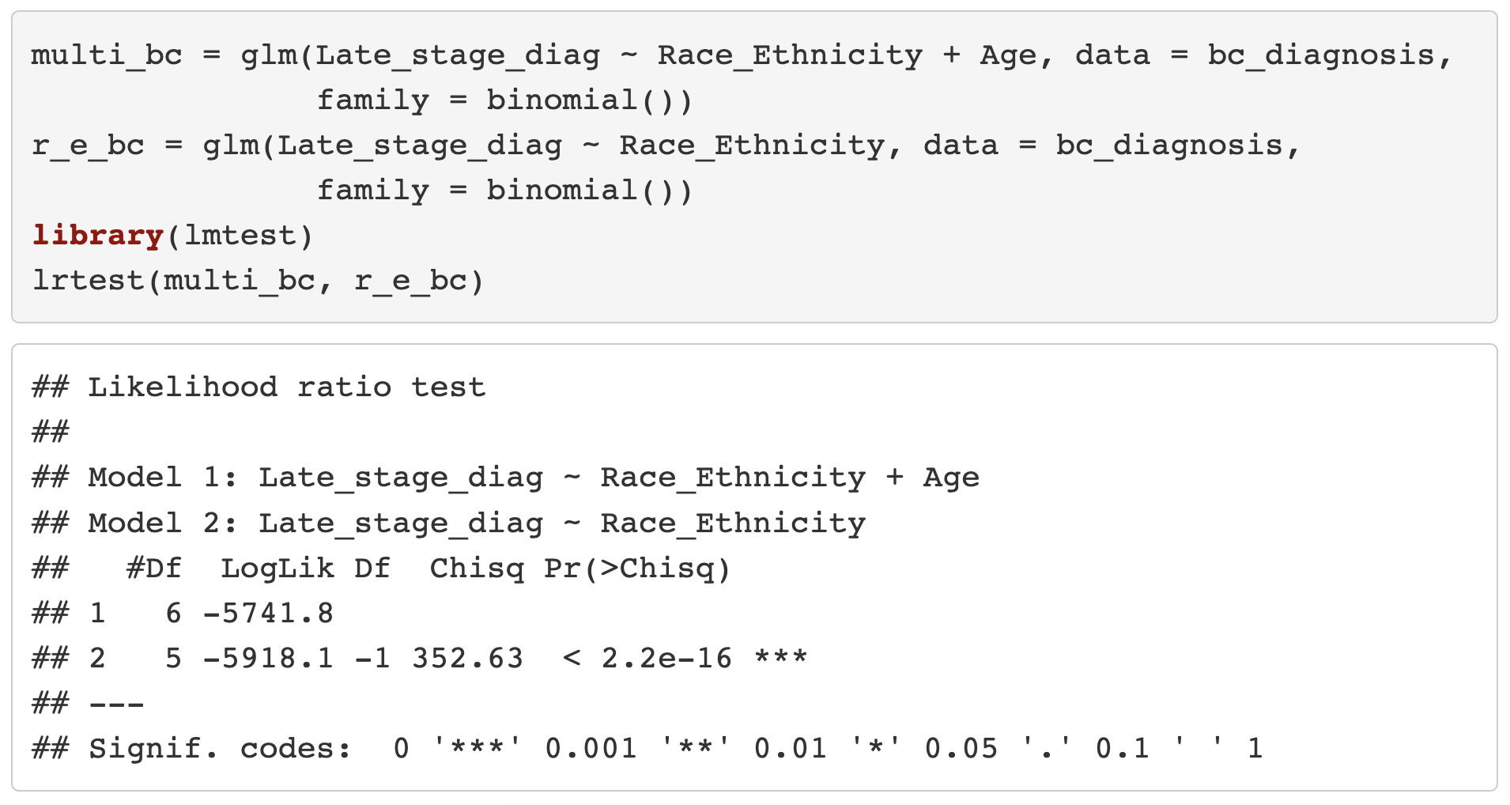
LRT Example 1: Breast Cancer Diagnosis (II)
Single, continuous variable: Age
2. Calculate G value

Slide 35
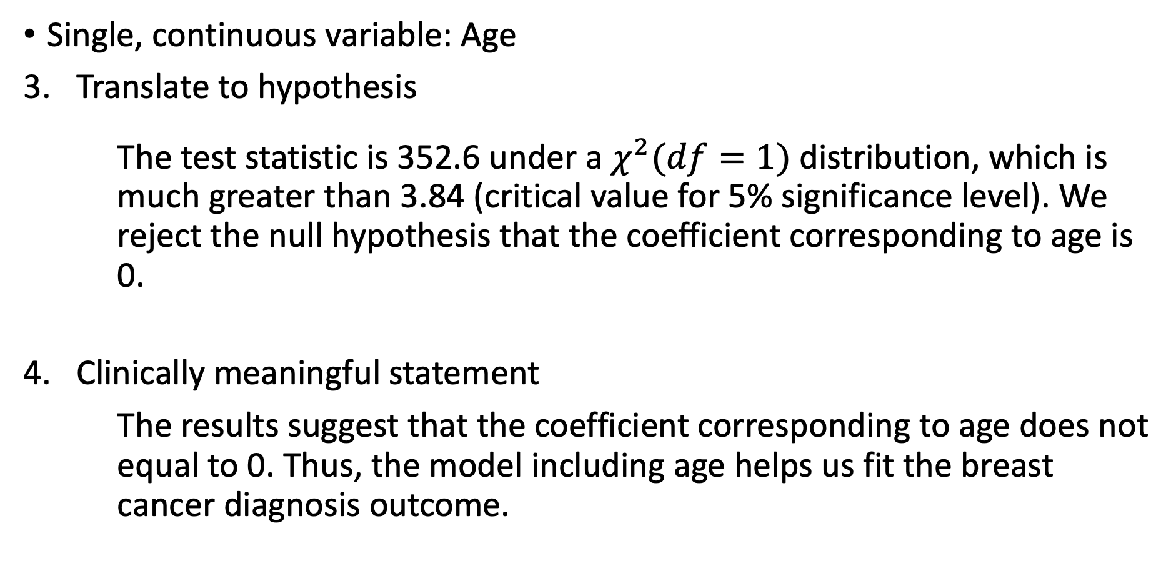
LRT Example 1: Breast Cancer Diagnosis (III)
Single, continuous variable: Age
Translate to hypothesis
The test statistic is 352.6 under a $χ^{2}(df=1)$ distribution, which is much greater than 3.84 (critical value for 5% significance level). We reject the null hypothesis that the coefficient corresponding to age is 0.
Clinically meaningful statement
The results suggest that the coefficient corresponding to age does not equal to 0. Thus, the model including age helps us fit the breast cancer diagnosis outcome.

Slide 36
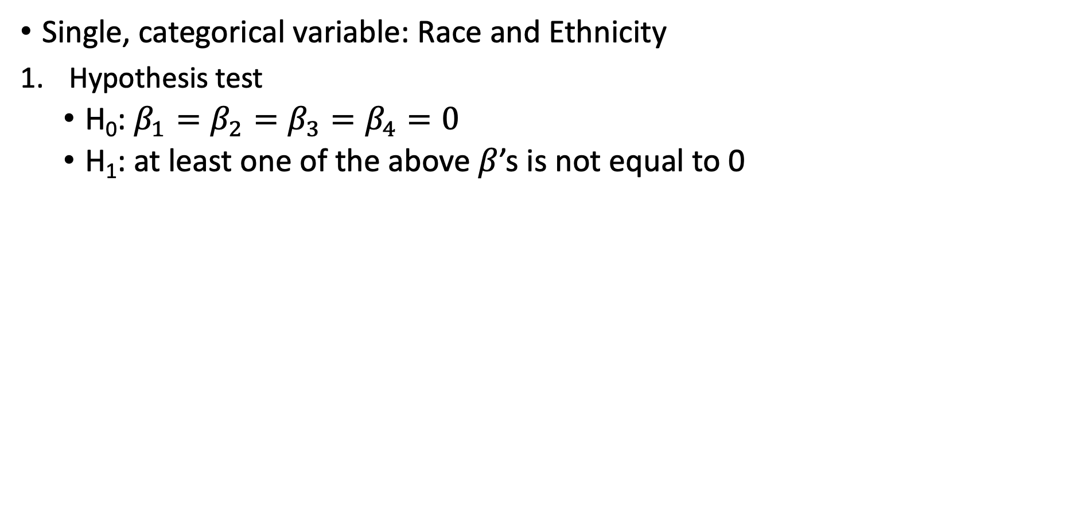
LRT Example 2: Breast Cancer Diagnosis (I)
Single, categorical variable: Race and Ethnicity
Hypothesis test
H₀: $β_{1}=β_{2}=β_{3}=β_{4}=0$
H₁: at least one of the above $β$’s is not equal to 0

Slide 37
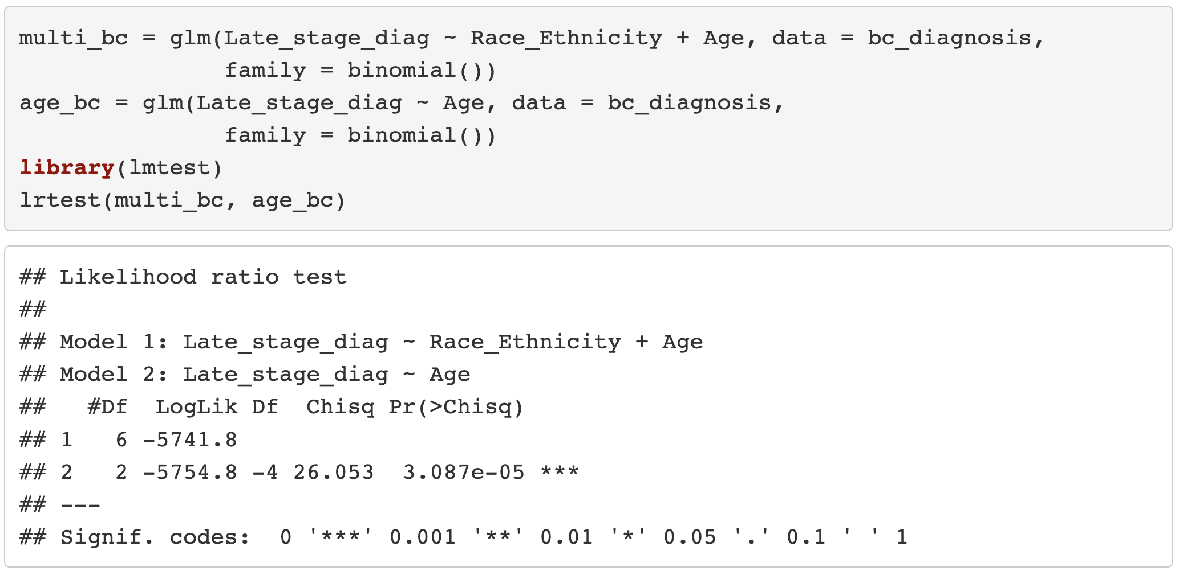
LRT Example 2: Breast Cancer Diagnosis (II)
Single, categorical variable: Race and Ethnicity
2. Calculate G

Slide 38
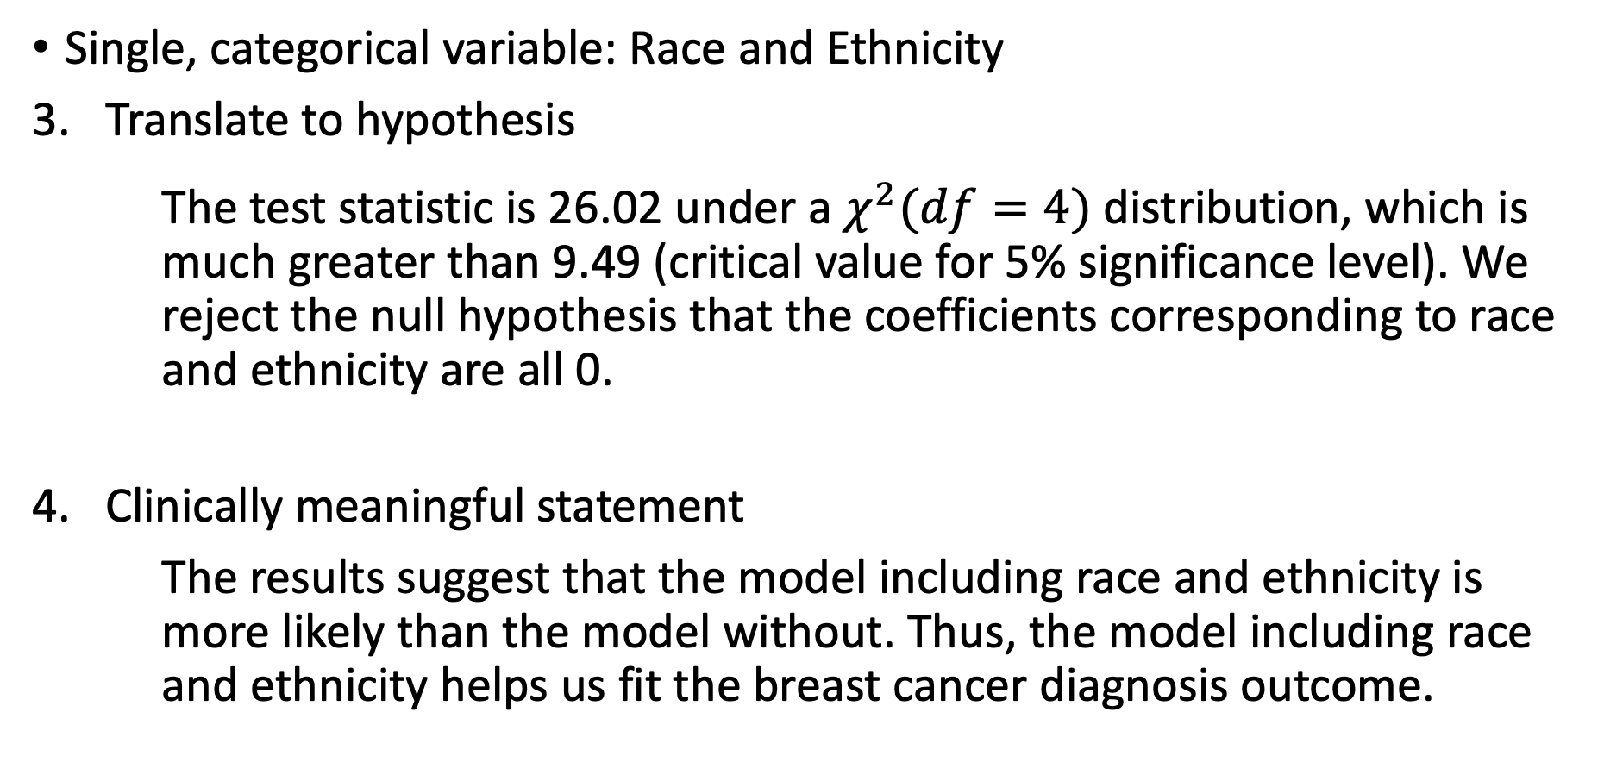
LRT Example 2: Breast Cancer Diagnosis (III)
Single, categorical variable: Race and Ethnicity
Translate to hypothesis
The test statistic is 26.02 under a $χ^{2}(df=4)$ distribution, which is much greater than 9.49 (critical value for 5% significance level). We reject the null hypothesis that the coefficients corresponding to race and ethnicity are all 0.
Clinically meaningful statement
The results suggest that the model including race and ethnicity is more likely than the model without. Thus, the model including race and ethnicity helps us fit the breast cancer diagnosis outcome.

Slide 39
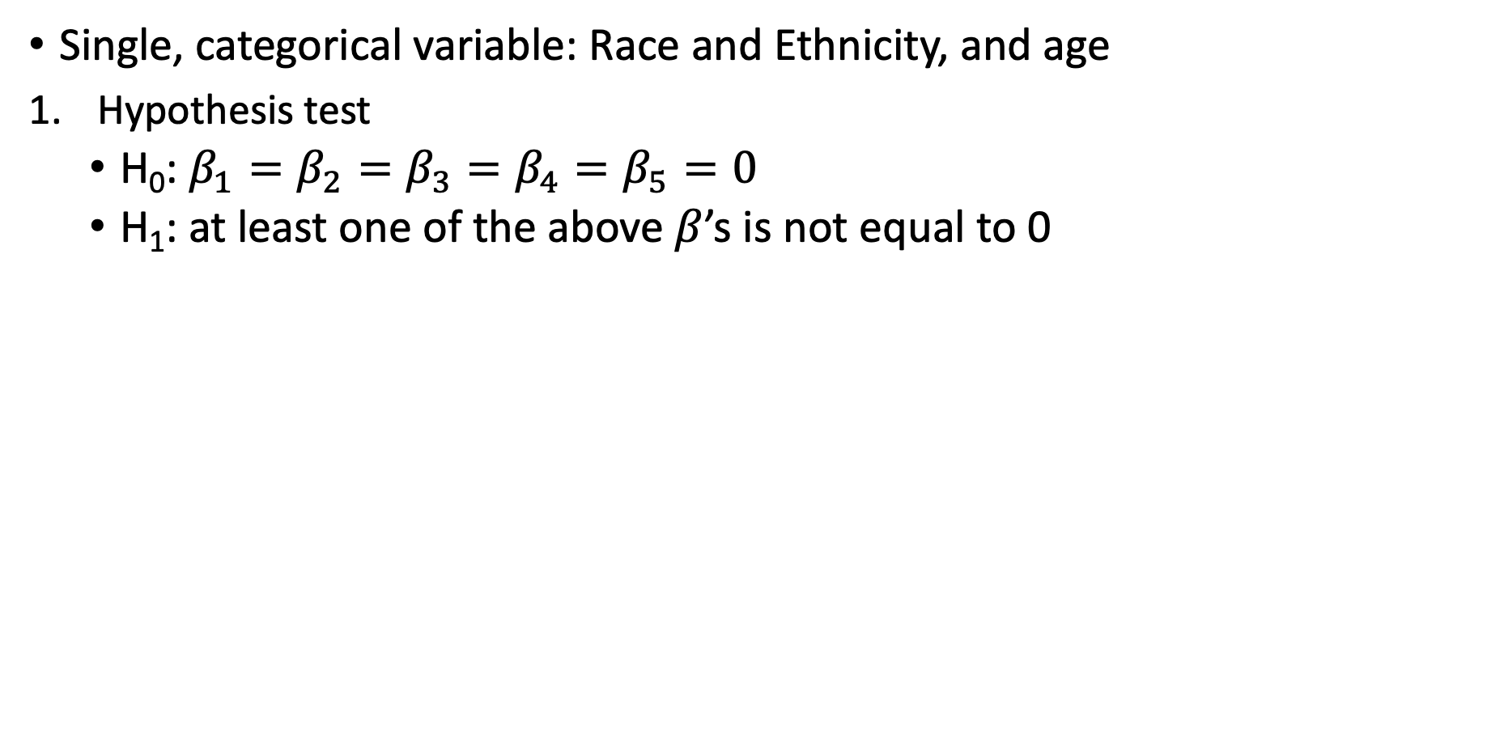
LRT Example 3: Breast Cancer Diagnosis (I)
Single, categorical variable: Race and Ethnicity, and age
Hypothesis test
H₀: $β_{1}=β_{2}=β_{3}=β_{4}=β_{5}=0$
H₁: at least one of the above $β$’s is not equal to 0

Slide 40
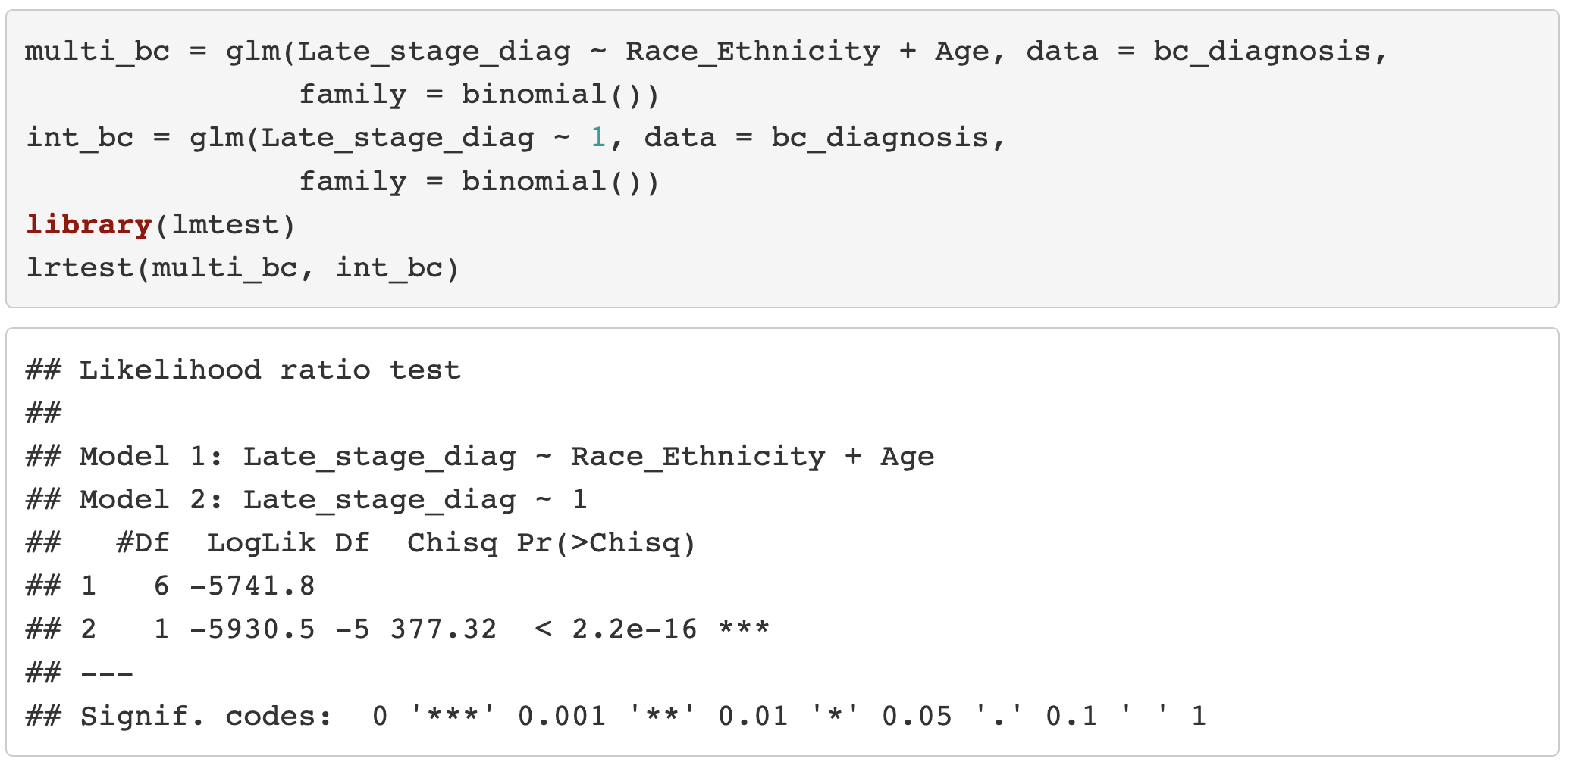
LRT Example 3: Breast Cancer Diagnosis (II)
Single, categorical variable: Race and Ethnicity
2. Calculate G

Slide 41
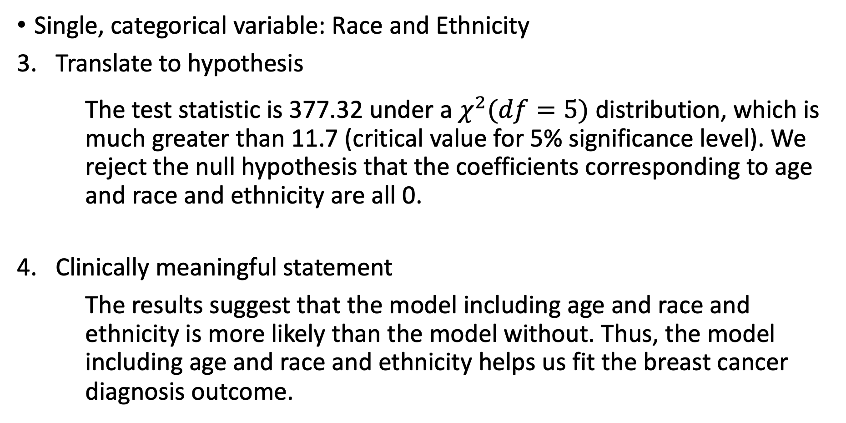
LRT Example 3: Breast Cancer Diagnosis (III)
Single, categorical variable: Race and Ethnicity
Translate to hypothesis
The test statistic is 377.32 under a $χ^{2}(df=5)$ distribution, which is much greater than 11.7 (critical value for 5% significance level). We reject the null hypothesis that the coefficients corresponding to age and race and ethnicity are all 0.
Clinically meaningful statement
The results suggest that the model including age and race and ethnicity is more likely than the model without. Thus, the model including age and race and ethnicity helps us fit the breast cancer diagnosis outcome.

Slide 42
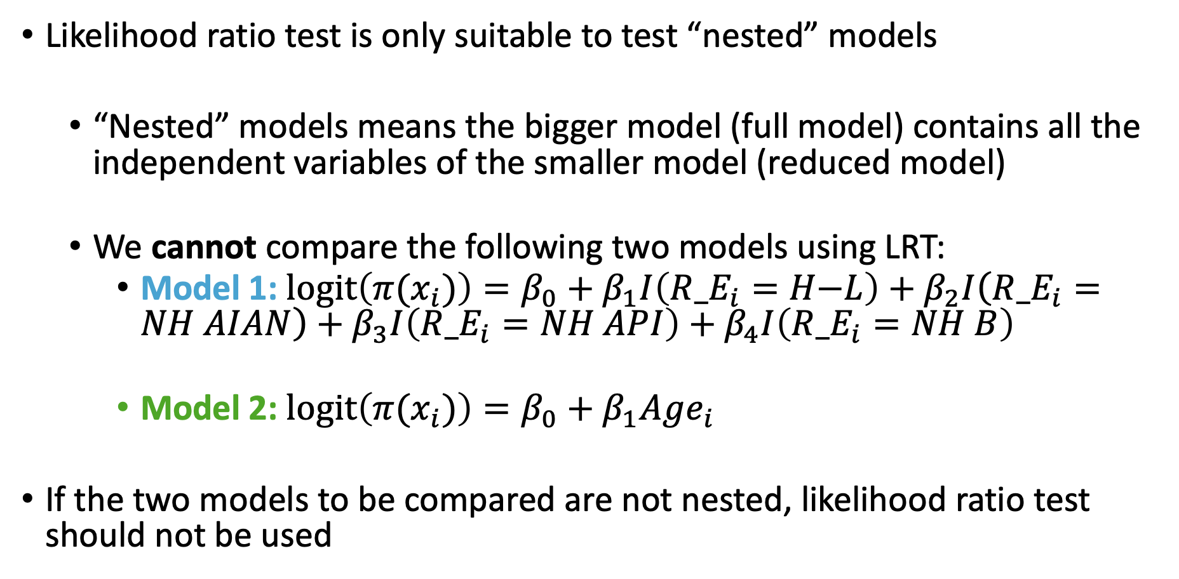
Notes on Likelihood Ratio Test
Likelihood ratio test is only suitable to test “nested” models
“Nested” models means the bigger model (full model) contains all the independent variables of the smaller model (reduced model)
We cannot compare the following two models using LRT:
Model 1: $l\text{ogit}\left(π(x_{i})\right)=β_{0}+β_{1}I\left({R_E}_{i}=H\text{−}L\right)+β_{2}I\left({R_E}_{i}=NH AIAN\right)+β_{3}I\left({R_E}_{i}=NH API\right)+β_{4}I\left({R_E}_{i}=NH B\right)$
Model 2: $l\text{ogit}\left(π(x_{i})\right)=β_{0}+β_{1}Age_{i}$
If the two models to be compared are not nested, likelihood ratio test should not be used

Slide 43
Class 8 Learning Objectives
From last class: Interpret coefficient estimates for continuous variables in simple logistic regression
Construct and fit a multiple logistic regression model
Test for significance of individual coefficients or sets of coefficients
Estimate the predicted probability of our outcome
Interpret odds ratios for coefficients while adjusting for other variables

Slide 44
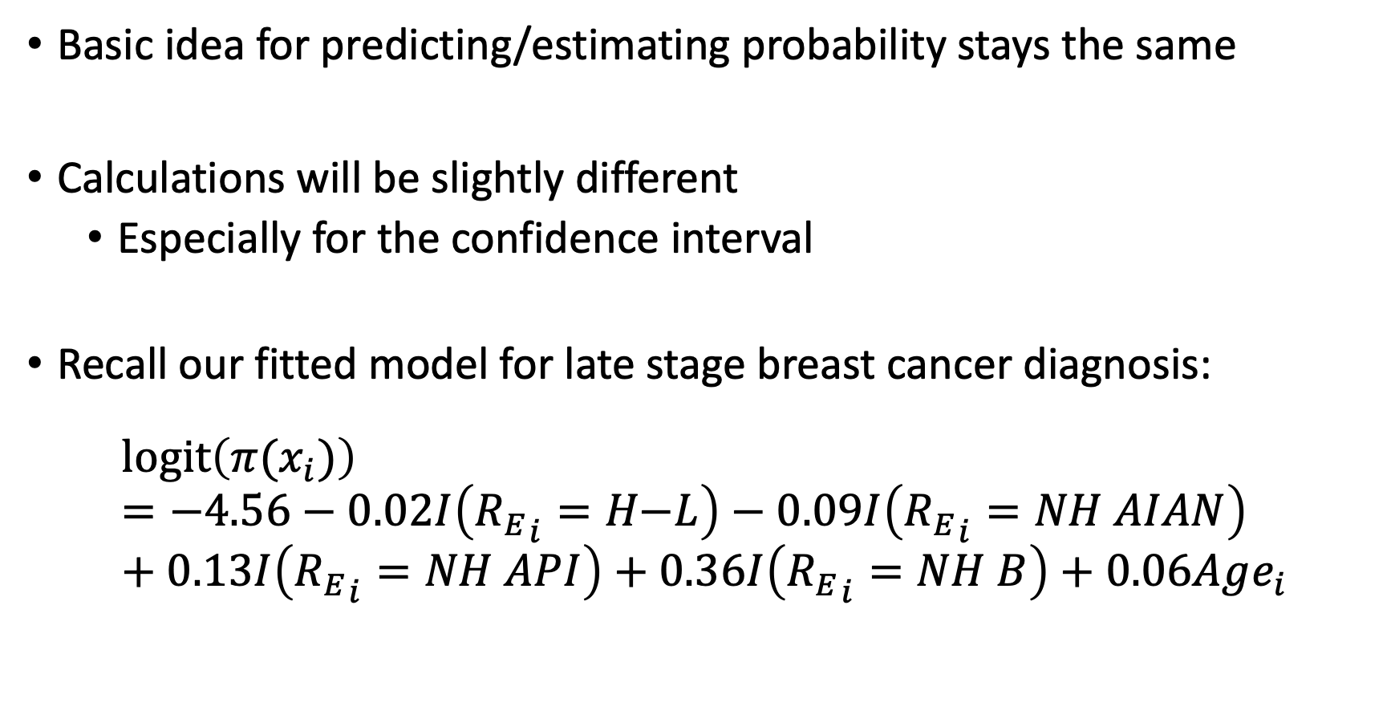
Estimated/Predicted Probability for MLR
Basic idea for predicting/estimating probability stays the same
Calculations will be slightly different
Especially for the confidence interval
Recall our fitted model for late stage breast cancer diagnosis:
$$l\text{ogit}\left(π(x_{i})\right)=−4.56−0.02I\left({R_{E}}_{i}=H\text{−}L\right)−0.09I\left({R_{E}}_{i}=NH AIAN\right)+0.13I\left({R_{E}}_{i}=NH API\right)+0.36I\left({R_{E}}_{i}=NH B\right)+0.06Age_{i}$$

Slide 45
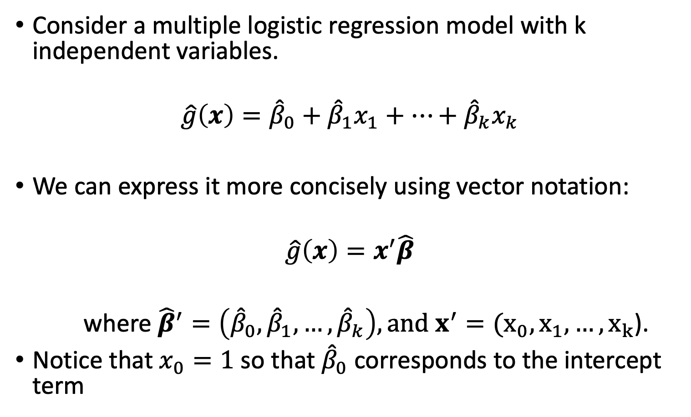
Confidence Interval for Predicted Probability (I)
Consider a multiple logistic regression model with k independent variables.
$$\hat{g}\left(x\right)={\hat{β}}_{0}+{\hat{β}}_{1}x_{1}+…+{\hat{β}}_{k}x_{k}$$
We can express it more concisely using vector notation:
$$\hat{g}\left(x\right)=x^{′}\hat{β}$$
where ${\hat{β}}^{′}=\left({\hat{β}}_{0},{\hat{β}}_{1},…,{\hat{β}}_{k}\right), and x^{′}=(x_{0},x_{1},…,x_{k}$).
Notice that $x_{0}=1$ so that ${\hat{β}}_{0}$ corresponds to the intercept term

Slide 46
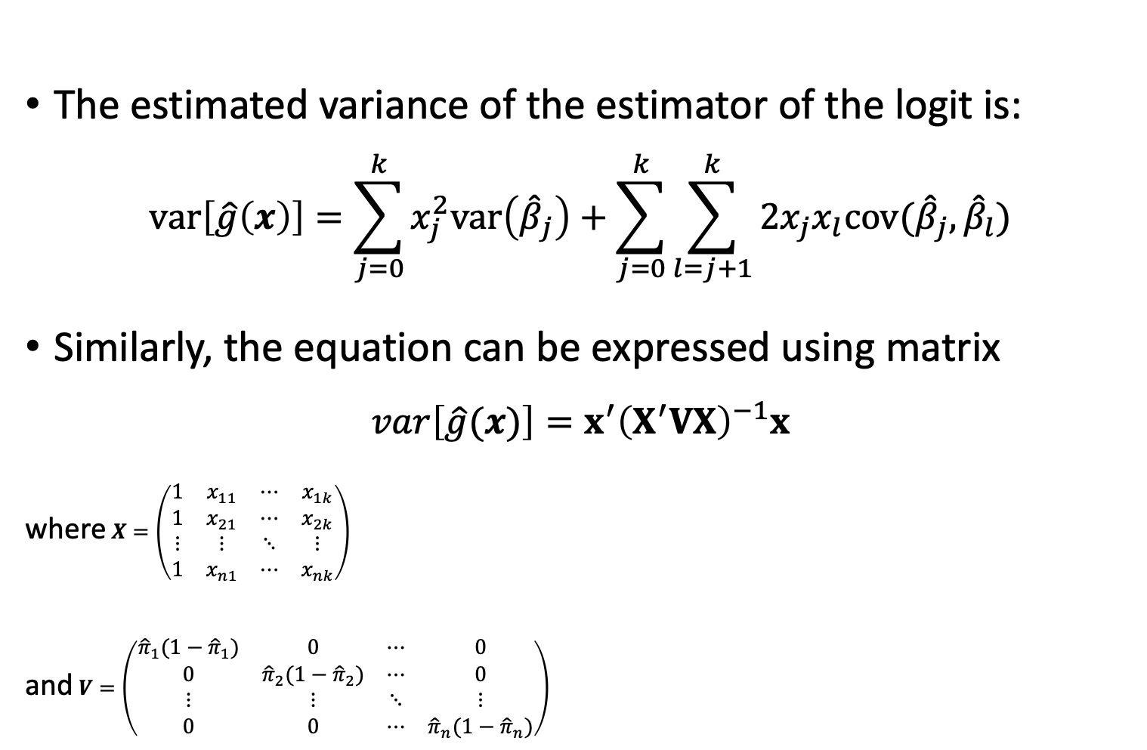
Confidence Interval for Predicted Probability (II)
The estimated variance of the estimator of the logit is:
$$var\left[\hat{g}\left(x\right)\right]=\sum_{j=0}^{k}{x_{j}^{2}var\left({\hat{β}}_{j}\right)+\sum_{j=0}^{k}{\sum_{l=j+1}^{k}{2x_{j}x_{l}cov({\hat{β}}_{j},{\hat{β}}_{l})}}}$$
Similarly, the equation can be expressed using matrix
$$var\left[\hat{g}(x)\right]=x^{′}{\left(X^{′}VX\right)}^{−1}x$$
where $X=\left(\begin{matrix}1 & x_{11} & ⋯ & x_{1k} \\ 1 & x_{21} & ⋯ & x_{2k} \\ ⋮ & ⋮ & ⋱ & ⋮ \\ 1 & x_{n1} & ⋯ & x_{nk}\end{matrix}\right)$
and $V=\left(\begin{matrix}{\hat{π}}_{1}(1−{\hat{π}}_{1}) & 0 & ⋯ & 0 \\ 0 & {\hat{π}}_{2}(1−{\hat{π}}_{2}) & ⋯ & 0 \\ ⋮ & ⋮ & ⋱ & ⋮ \\ 0 & 0 & ⋯ & {\hat{π}}_{n}(1−{\hat{π}}_{n})\end{matrix}\right)$

Slide 47
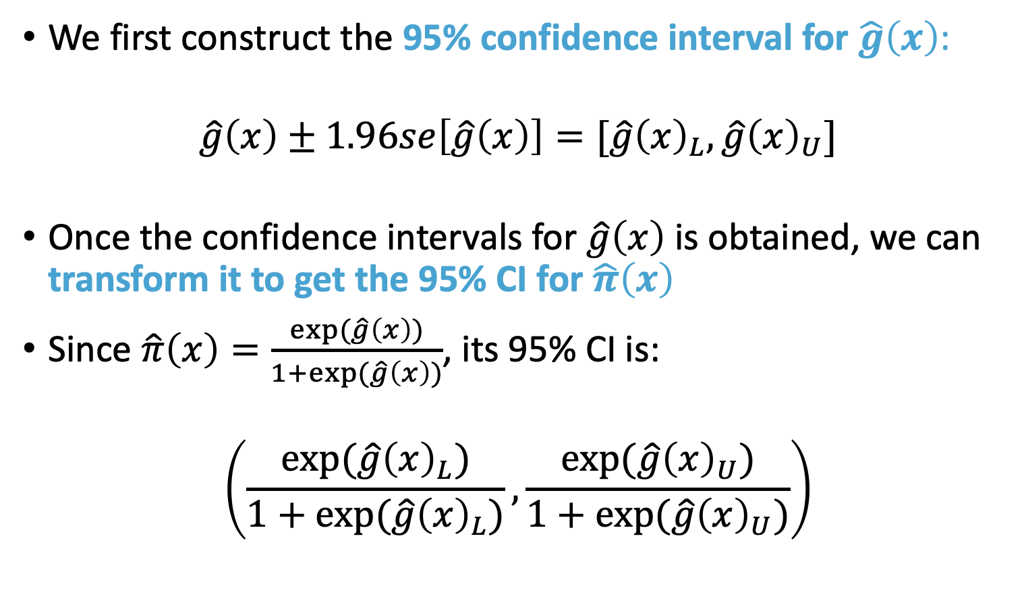
Confidence Interval for Predicted Probability (III)
We first construct the 95% confidence interval for $\hat{g}\left(x\right)$:
$$\hat{g}\left(x\right)±1.96se\left[\hat{g}\left(x\right)\right]=[\hat{g}{\left(x\right)}_{L},\hat{g}{\left(x\right)}_{U}]$$
Once the confidence intervals for $\hat{g}\left(x\right)$ is obtained, we can transform it to get the 95% CI for $\hat{π}\left(x\right)$
Since $\hat{π}\left(x\right)=\frac{exp⁡(\hat{g}\left(x\right))}{1+exp⁡(\hat{g}\left(x\right))}$, its 95% CI is:
$$\left(\frac{exp⁡(\hat{g}{\left(x\right)}_{L})}{1+exp⁡(\hat{g}{\left(x\right)}_{L})},\frac{exp⁡(\hat{g}{\left(x\right)}_{U})}{1+exp⁡(\hat{g}{\left(x\right)}_{U})}\right)$$

Slide 48
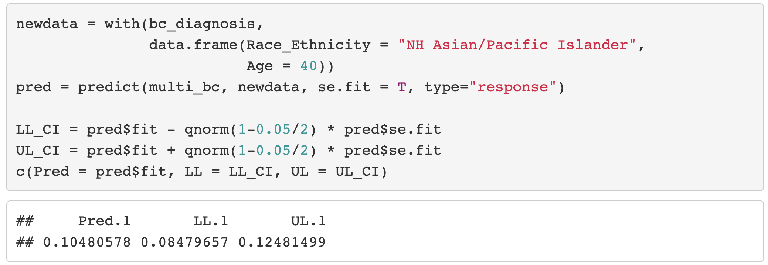
Prediction and Confidence Interval in R

Slide 49
Class 8 Learning Objectives
From last class: Interpret coefficient estimates for continuous variables in simple logistic regression
Construct and fit a multiple logistic regression model
Test for significance of individual coefficients or sets of coefficients
Estimate the predicted probability of our outcome
Interpret odds ratios for coefficients while adjusting for other variables

Slide 50
Multivariable Logistic Regression Model
The multivariable model of logistic regression (called multiple logistic regression) is useful in that it statistically adjusts the estimated effect of each variable in the model
Each estimated coefficient provides an estimate of the log odds adjusting for all other variables included in the model
The adjusted odds ratio can be different from or similar to the unadjusted odds ratio
Comparing adjusted vs. unadjusted odds ratios is a useful activity.

Slide 51
Interpretation of Coefficients in MLR
The interpretation of coefficients in multiple logistic regression is essentially the same as the interpretation of coefficients in simple logistic regression
For interpretation, we need to
point out that these are adjusted estimates
provide a list of other variables in the model

Slide 52
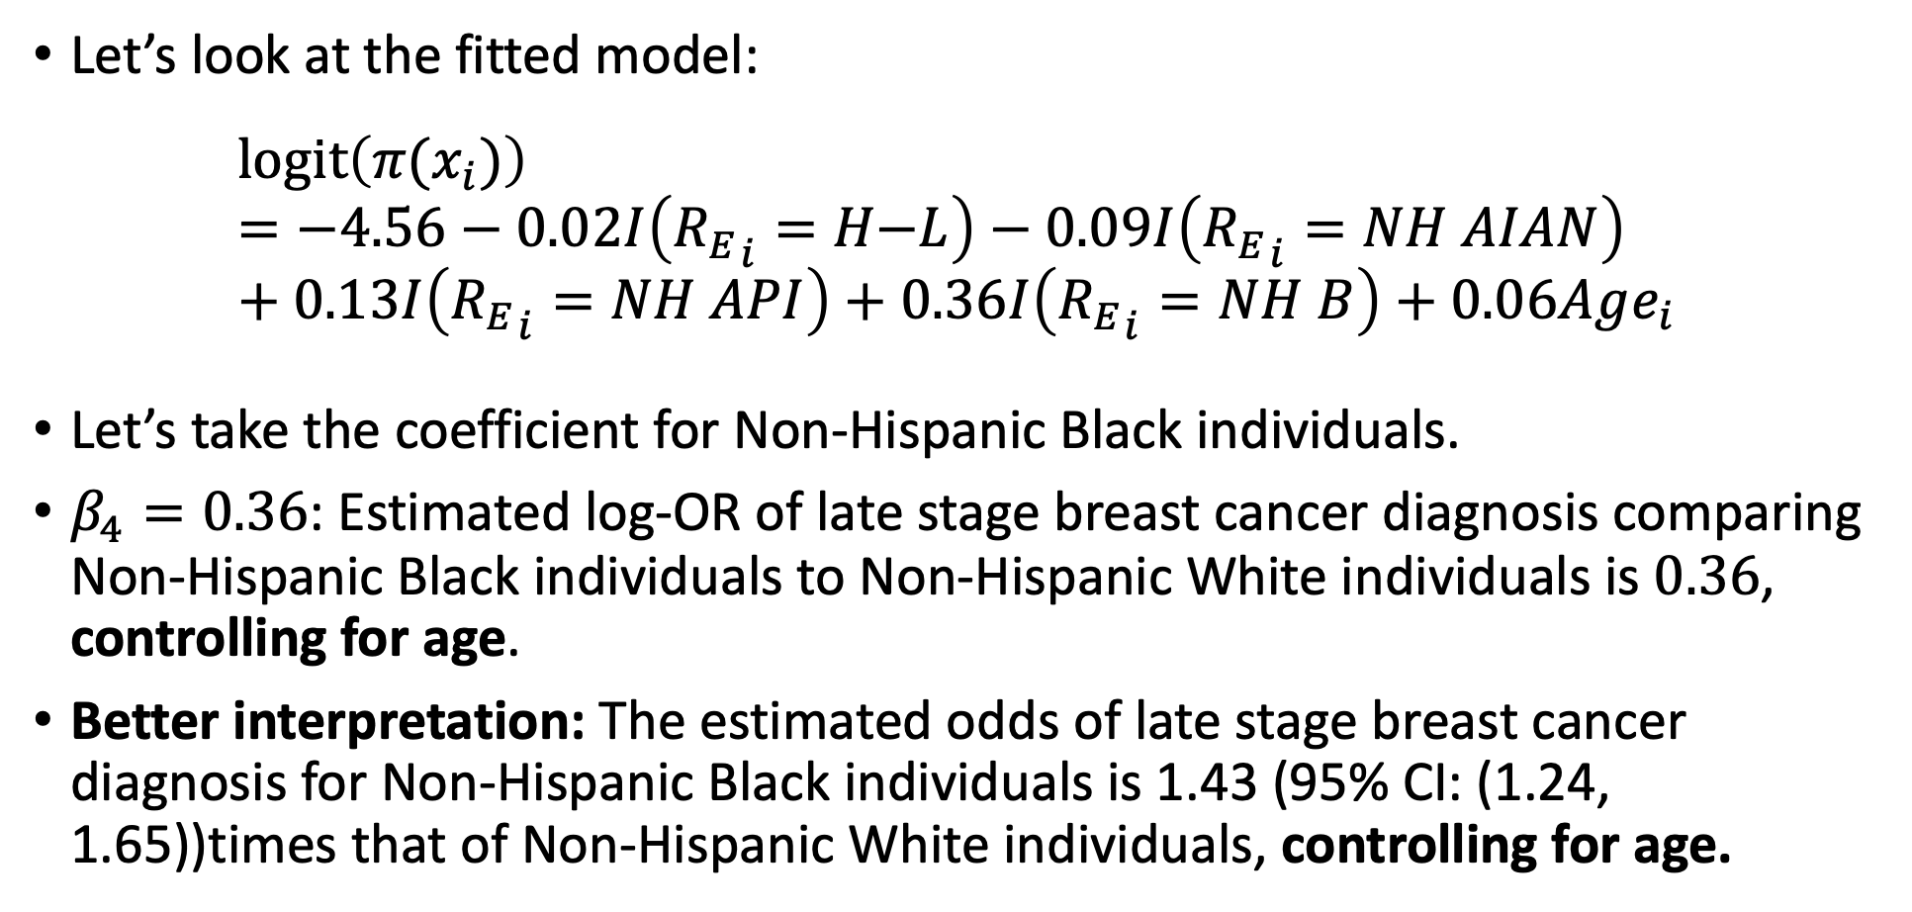
Example: Race and Ethnicity and Age model fit
Let’s look at the fitted model:
$$l\text{ogit}\left(π(x_{i})\right)=−4.56−0.02I\left({R_{E}}_{i}=H\text{−}L\right)−0.09I\left({R_{E}}_{i}=NH AIAN\right)+0.13I\left({R_{E}}_{i}=NH API\right)+0.36I\left({R_{E}}_{i}=NH B\right)+0.06Age_{i}$$
Let’s take the coefficient for Non-Hispanic Black individuals.
$β_{4}=0.36$: Estimated log-OR of late stage breast cancer diagnosis comparing Non-Hispanic Black individuals to Non-Hispanic White individuals is $0.36$, controlling for age.
Better interpretation: The estimated odds of late stage breast cancer diagnosis for Non-Hispanic Black individuals is 1.43 (95% CI: (1.24, 1.65))times that of Non-Hispanic White individuals, controlling for age.

Slide 53
What does “controlling for” mean? (I)
Consider a multivariable model with two independent variables: one dichotomous (the risk factor) and one continuous (say, age)
Primary interest: to estimate the effect of the risk factor on the outcome variable
But we want to assess whether to adjust for age
Adjusting for age may not be necessary if age distribution is quite similar for the exposed and unexposed groups
But if the age distribution does differs for the two groups (for example, the exposed group are older than the unexposed group), we need to adjust for age using multivariable regression modeling

Slide 54
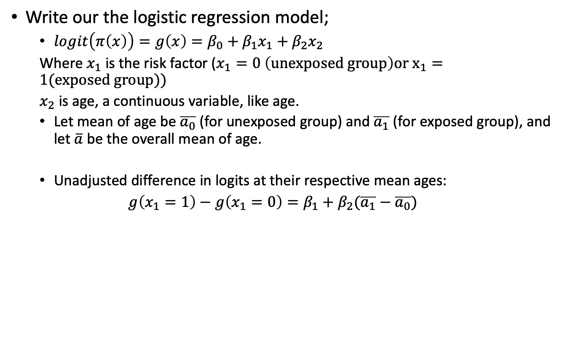
What does “controlling for” mean? (II)
Write our the logistic regression model;
$logit\left(π\left(x\right)\right)=g\left(x\right)=β_{0}+β_{1}x_{1}+β_{2}x_{2}$
Where $x_{1}$ is the risk factor ($x_{1}=0 \left(unexposed group\right)or x_{1}=1(exposed group))$
$x_{2}$ is age, a continuous variable, like age.
Let mean of age be $\overline{a_{0}}$ (for unexposed group) and $\overline{a_{1}}$ (for exposed group), and let $\overline{a}$ be the overall mean of age.
Unadjusted difference in logits at their respective mean ages:
$g\left(x_{1}=1\right)−g\left(x_{1}=0\right)=β_{1}+β_{2}(\overline{a_{1}}−\overline{a_{0}})$

Slide 55
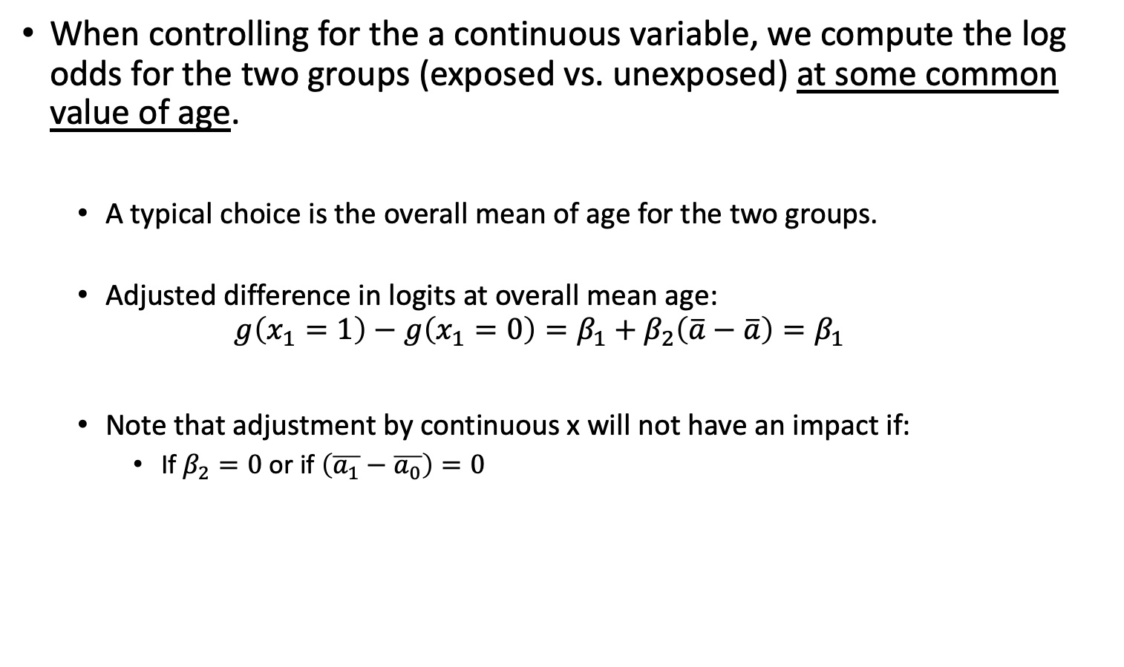
What “controlling for” Means (III)
When controlling for the a continuous variable, we compute the log odds for the two groups (exposed vs. unexposed) at some common value of age.
A typical choice is the overall mean of age for the two groups.
Adjusted difference in logits at overall mean age:
$$g\left(x_{1}=1\right)−g\left(x_{1}=0\right)=β_{1}+β_{2}\left(\overline{a}−\overline{a}\right)=β_{1}$$
Note that adjustment by continuous x will not have an impact if:
If $β_{2}=0$ or if $\left(\overline{a_{1}}−\overline{a_{0}}\right)=0$

Slide 56
Stop here??

Slide 57
Re-visit Confounding
A confounding variable, or confounder, is an extraneous factor that wholly or partially accounts for the observed effect of the risk factor on disease status.
A confounder must be
related to the outcome Y, but not a consequence of Y.
related to the explanatory variable X, but not a consequence of X.

Slide 58
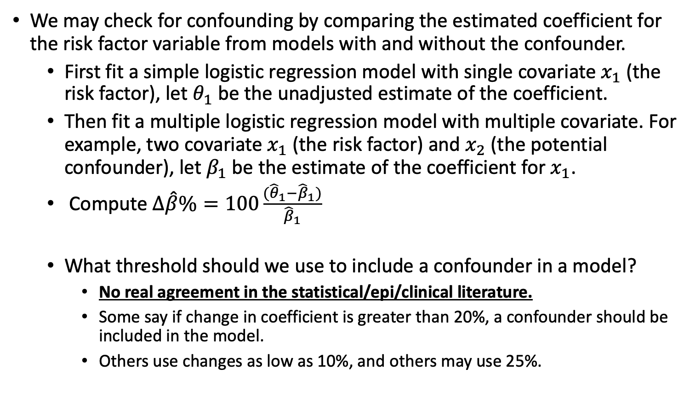
Test for Confounding (I)
We may check for confounding by comparing the estimated coefficient for the risk factor variable from models with and without the confounder.
First fit a simple logistic regression model with single covariate $x_{1}$ (the risk factor), let $θ_{1}$ be the unadjusted estimate of the coefficient.
Then fit a multiple logistic regression model with multiple covariate. For example, two covariate $x_{1}$ (the risk factor) and $x_{2}$ (the potential confounder), let $β_{1}$ be the estimate of the coefficient for $x_{1}$.
Compute $Δ\hat{β}\%=100\frac{({\hat{θ}}_{1}−{\hat{β}}_{1})}{{\hat{β}}_{1}}$
What threshold should we use to include a confounder in a model?
No real agreement in the statistical/epi/clinical literature.
Some say if change in coefficient is greater than 20%, a confounder should be included in the model.
Others use changes as low as 10%, and others may use 25%.
Note that this is change based on regression coefficient NOT ODDS RATIO!

Slide 59
Test for Confounding (II)
We may test the significance of any variable (including confounder) using hypothesis testing (say, likelihood ratio test).
It is generally suggested to include a confounder in the model if it is statistically significantly associated with the outcome itself.
A statistically insignificant confounder may stay in the model if it is determined that the change in the estimated coefficient for the risk factor with and without the risk factor is “clinically or biologically important”.
Whether it reaches a desired change threshold or not!

Slide 60
Confounding vs. Interaction
The adjusted odds ratio for one variable adjusting for confounders can be quite different from unadjusted odds ratio.
Variables that are used to adjust the effects of others are called confounders.
Adjusting for them is called controlling for confounding.
When odds ratio for one variable is not constant over the levels of another variable, the two variables are said to have a statistical interaction (sometimes also called effect modification).
i.e., the log odds of one variable is modified/changed by values of the other variable.
A variable is an effect modifier if it interacts with a risk factor.

Slide 61
Interaction (I)
We have learned how to compute adjust RR and OR using Mantel-Haenszel method in the presence of one or more categorical confounders.
The Mantel-Haenszel method
Provides a pooled estimate of the adjusted RR or OR.
It is a weighed average of the odds ratios from the individual strata.
It assumes there is a true OR (or RR) which is consistent across all strata.
We have learned to use Breslow-Day test for testing homogeneity of ORs across all strata .
If the test suggests the ORs are heterogeneous (i.e., interaction presence), Mantel-Haenszel adjusted odds ratio should NOT be reported.

Slide 62
Interaction (II)
We also learned that multiple logistic regression (MLR) model can be used for adjusting for confounders.
MLR is more general in that it is suitable for one or more confounders, and the confounders can be either categorical or continuous independent variable.
The adjusted OR using MLR is often very close to the adjusted OR using Mantel-Haenszel method.
Similarly, the adjusted OR using MLR should ONLY be reported when there is no interaction.
No interaction means the OR across strata is homogeneous.
Test of Interaction in MLR is very similar to Breslow-Day test of homogeneity.

Slide 63
Example of interaction
Example of interaction:
In a cohort study of elderly people the chance of death within 2 years was much higher for those who had previously suffered a hip fracture at the start of these 2 years, but the excess risk associated with a hip fracture was significantly higher for men than women.
This is an interaction between hip fracture status (yes/no) and sex.
Odds ratio for females > odds ratio males

Slide 64
Types of Interaction (I)
Consider the interaction diagrams (shown in next slide) which illustrate three potential effects of interaction between two covariates A and B.
No interaction between A and B.
Unilateralism: exposure to A has no effect in the absence of exposure to B, but a considerable effect when B is present.
Synergism: the effect of A is in the same direction, but stronger in the presence of B.
Antagonism: the effect of A works in the opposite direction in the presence of B.

Slide 65
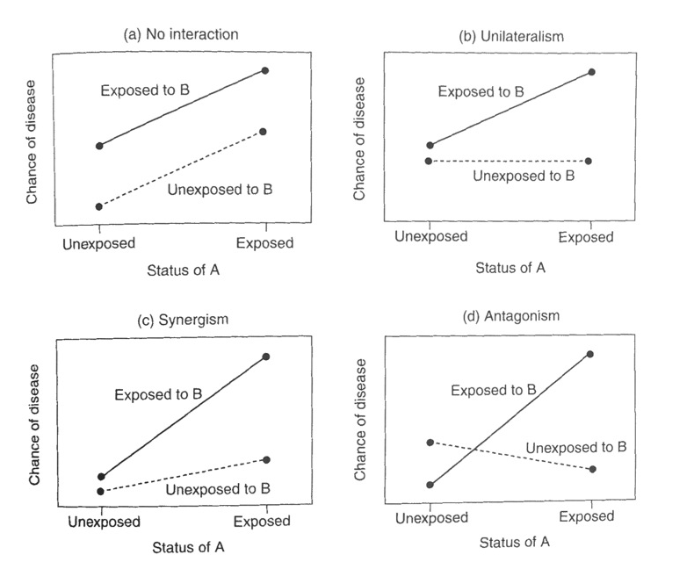
Types of Interaction (II)
Figure 9.1: interaction diagrams
No interaction between A and B
exposure to A has no effect in the absence of exposure to B, but a considerable effect when B is present
the effect of A is in the same direction, but stronger in the presence of B
the effect of A works in the opposite direction in the presence of B

Slide 66
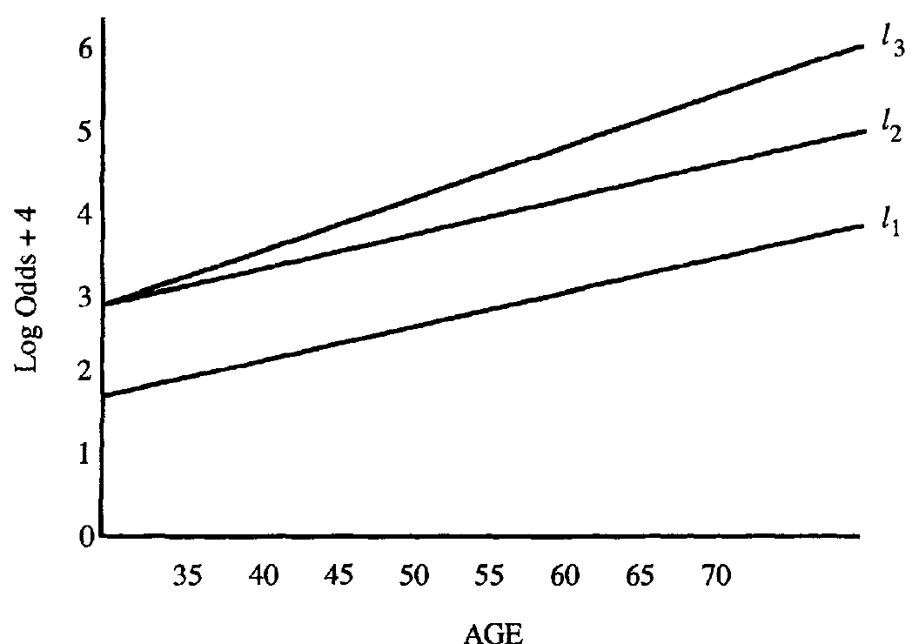
Understand the Interaction (I)
See Figure 9.2 below, which plots the logits under three different models showing the presence and absence of interaction.
Response variable: CHD; Risk factor: sex; covariate to be controlled: age.
Logit for male (with interaction)
Logit for male (w/o interaction)
Logit for female

Slide 67
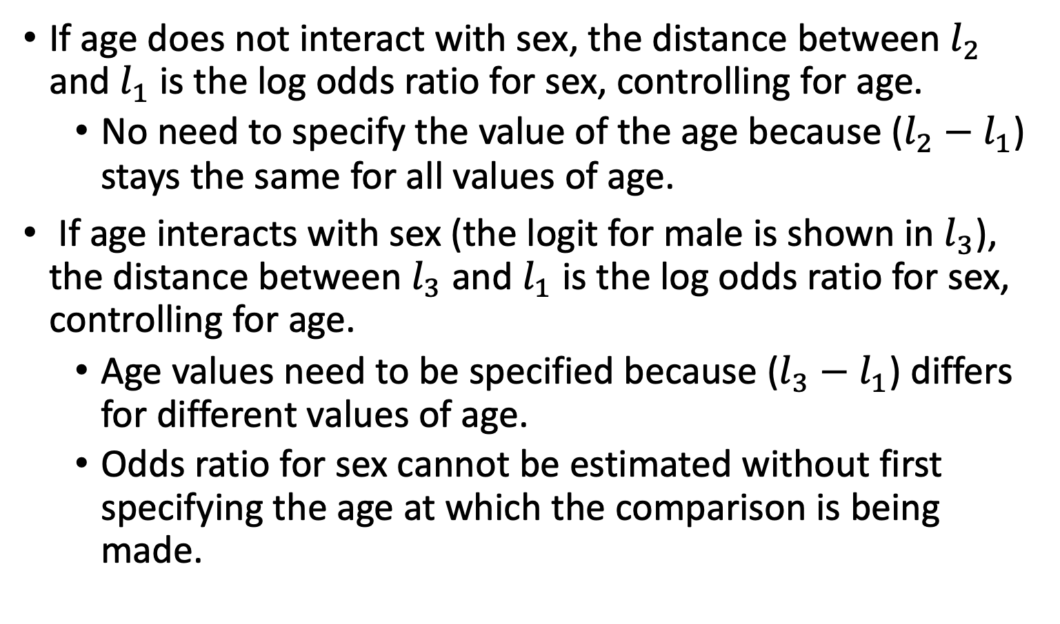
Understand the Interaction (II)
If age does not interact with sex, the distance between $l_{2}$ and $l_{1}$ is the log odds ratio for sex, controlling for age.
No need to specify the value of the age because ($l_{2}−$ $l_{1}$) stays the same for all values of age.
If age interacts with sex (the logit for male is shown in $l_{3}$), the distance between $l_{3}$ and $l_{1}$ is the log odds ratio for sex, controlling for age.
Age values need to be specified because ($l_{3}−$ $l_{1}$) differs for different values of age.
Odds ratio for sex cannot be estimated without first specifying the age at which the comparison is being made.

Slide 68
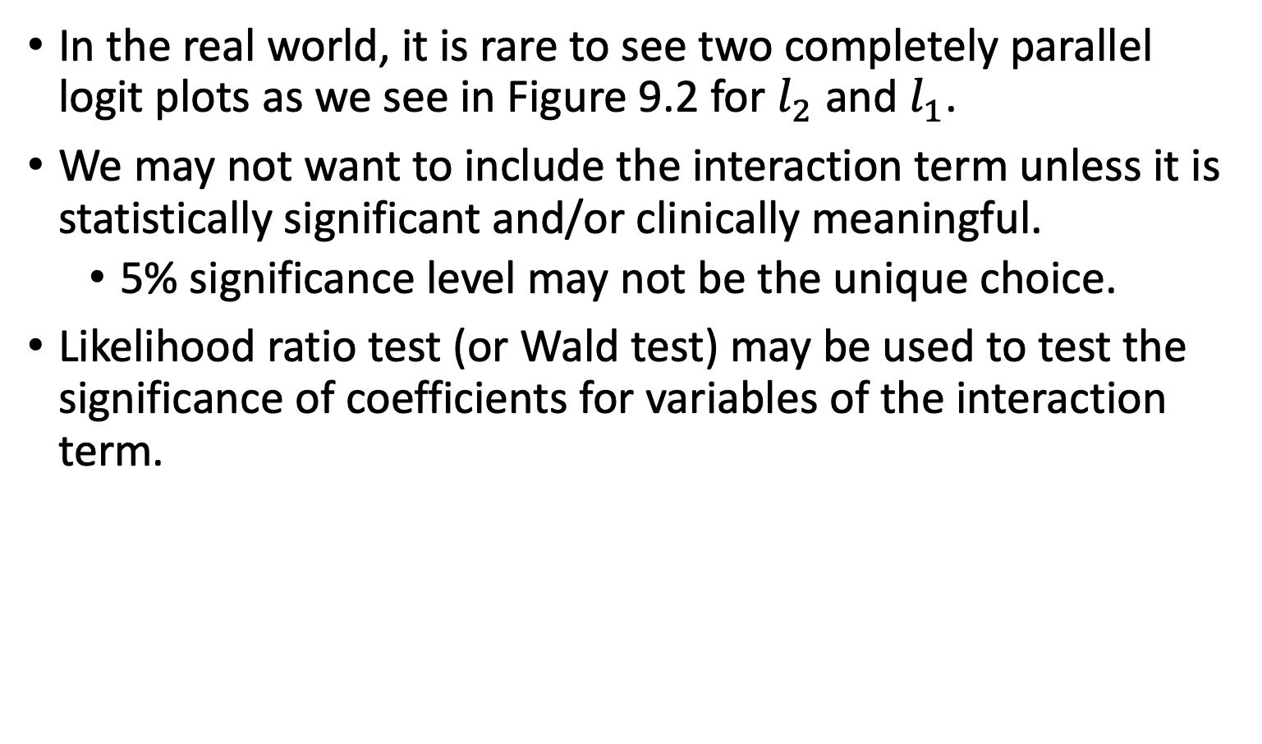
Understand the Interaction (III)
In the real world, it is rare to see two completely parallel logit plots as we see in Figure 9.2 for $l_{2}$ and $l_{1}$.
We may not want to include the interaction term unless it is statistically significant and/or clinically meaningful.
5% significance level may not be the unique choice.
Likelihood ratio test (or Wald test) may be used to test the significance of coefficients for variables of the interaction term.

Slide 69
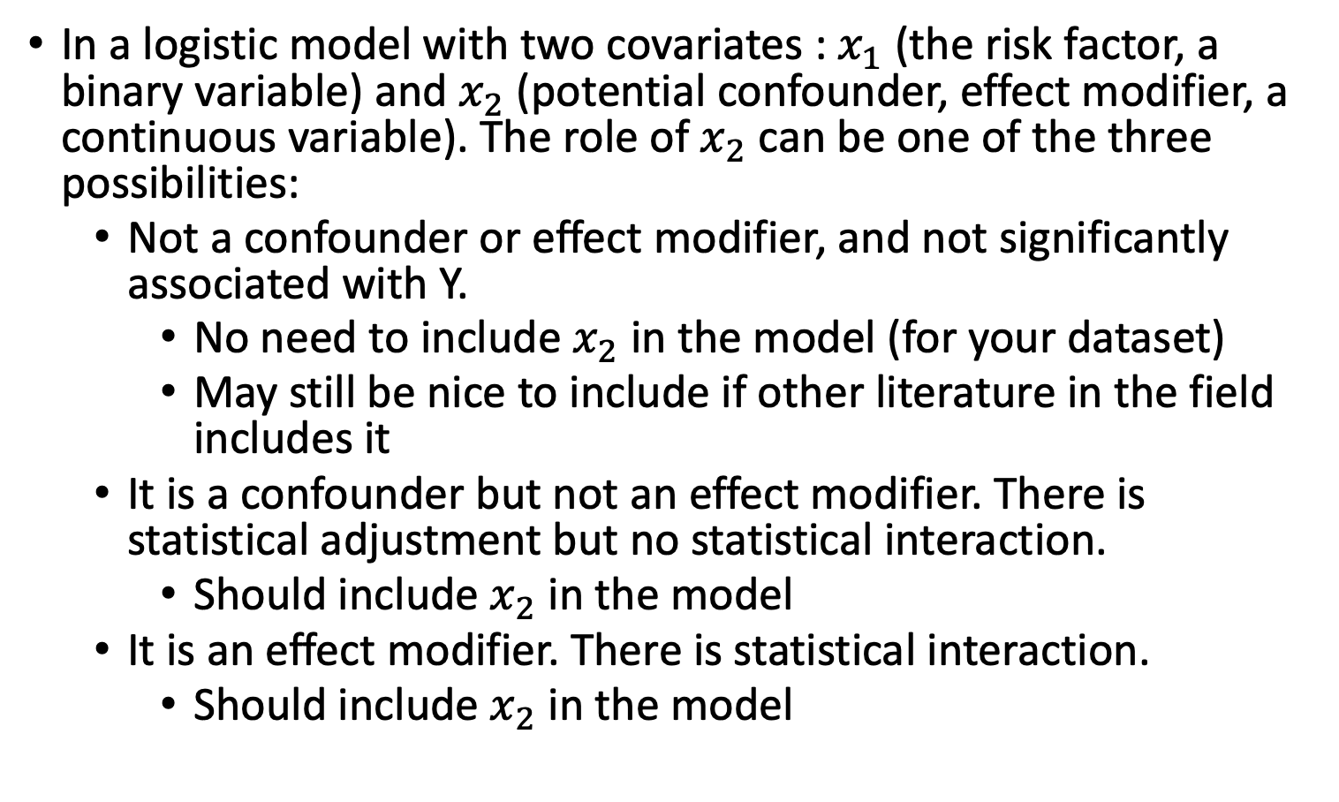
A Summary
In a logistic model with two covariates : $x_{1}$(the risk factor, a binary variable) and $x_{2}$ (potential confounder, effect modifier, a continuous variable). The role of $x_{2}$ can be one of the three possibilities:
Not a confounder or effect modifier, and not significantly associated with Y.
No need to include $x_{2}$ in the model (for your dataset)
May still be nice to include if other literature in the field includes it
It is a confounder but not an effect modifier. There is statistical adjustment but no statistical interaction.
Should include $x_{2}$ in the model
It is an effect modifier. There is statistical interaction.
Should include $x_{2}$ in the model

Slide 70
Class 8 Learning Objectives
From last class: Interpret coefficient estimates for continuous variables in simple logistic regression
Construct and fit a multiple logistic regression model
Test for significance of individual coefficients or sets of coefficients
Estimate the predicted probability of our outcome
Interpret odds ratios for coefficients while adjusting for other variables

Slide 71
Wrap-up
No exit ticket today!!
Next class
More about coefficients and interactions next class!
More about model building!

